Slide 1
Justice40 Capacity Building Cohort
Session Two
June 13, 2024

Slide 2
Agenda
Introductions
Technical assistance
Justice40 grant writing
Breakouts
Next steps
Homework
Justice40 worksheet

Slide 3
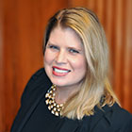
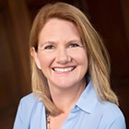
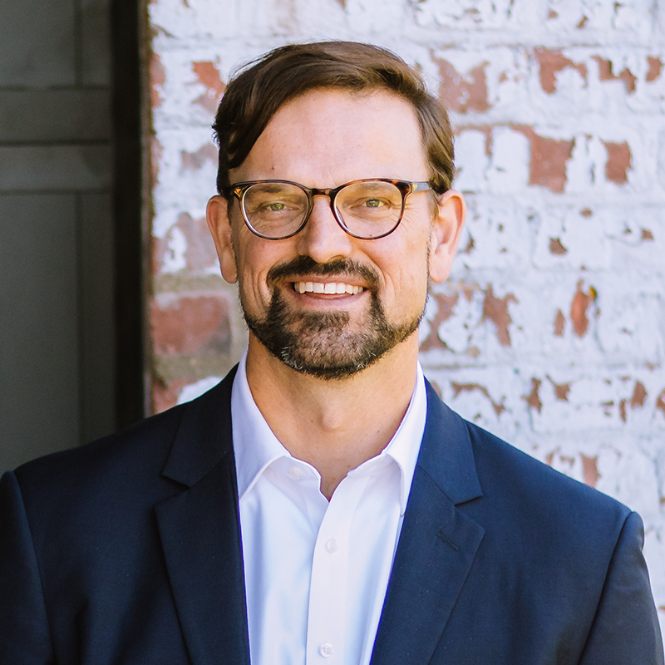
Introductions
Michigan Municipal League
Public Sector Consultants
OHM Advisors
Madigan Consulting
Melissa Milton-Pung,
Program Manager
Shanna Draheim, Director of Policy
Lydia Schaafsma, Program Associate
Joel Howrani Heeres, AICP,
Director of Community Resilience
Meagan O’Brien, Consultant
Madison Merzlyakov, Client Representative
Kate Madigan, Climate and Energy Consultant
Notes:
Icebreaker:

Slide 4
Technical Assistance
helpdesk@mifundinghub.org
Send a message to the Helpdesk email address. We will reply with an intake form and follow-up questions.
Fill out the intake form and we’ll coordinate a time to meet virtually.
Talk to our grant experts to discuss funding gaps and opportunities. This meeting is usually 30–45 minutes long.
Receive follow-up support as needed. This support may include the Helpdesk searching for additional funding opportunities or peer reviewing your funding applications.
Notes:
Hand back to Joel

Slide 5
Successful Grant Applications for J40 Communities
Kate Madigan, Madigan Consulting
5 Lakes Energy Community Grants Program
June 13, 2024

Slide 6
Justice40 Intiative and Funding for Climate
Bipartisan Infrastructure Law (BIL) Nov 2021 - $1.2 T ($550B new)
Inflation Reduction Act (IRA) Aug 2022 Energy & Climate - $370B
infrastructure
Justice 40 Initiative:
Federal government commitment that 40 percent of overall benefits of certain federal investments flow to disadvantaged communities.
Co
Covered Programs: Climate change, clean energy and efficiency, transit, housing, workforce development, remediation, and clean water and wastewater infrastructure

Slide 7
Broad range of grant opportunities
Community Energy Management Grants (EGLE)
Up to $100,000 for local governments, tribes
Applications due June 30
MI EJ Impact Grants (EGLE)
Up to $500,000 for local governments, tribes, NGOs
Applications due July 15
Community Change Grants (EPA)
$10M-20M grants to coalitions that includes NGO in J40 community
Applications due November 21, 2024 or until funds run out

Slide 8
How to highlight J40 in grant applications
Depends on the grant:
Must be J40 to apply - in some cases
For example, EPA Community Change Grants
Priority given to J40 communities - in all cases
Federal and State grants

Slide 9
How to highlight J40 in grant applications
Depends on the grant:
Check a box
Use MI EJScreen, CEJST, or EPA EJ Screen tool
Describe in narrative

Slide 10
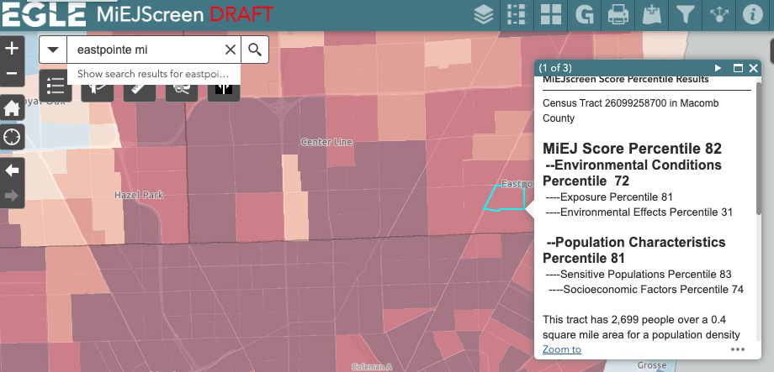
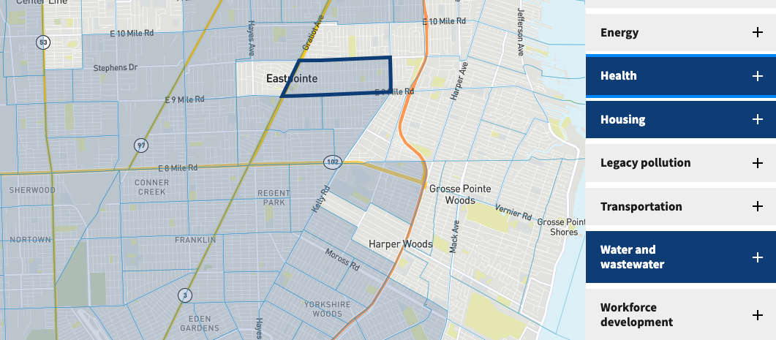
How to highlight J40 in grant applications
CEJST

Slide 11
How to highlight J40 in grant applications
“The unemployment rate is 8%, nearly twice the statewide average of 4.6%, while median household income is $44,904, two-thirds of the statewide figure ($68,505)”
“Our community is in 98th percentile or above in the nation for particulate matter, toxic releases to air, lead paint, traffic proximity, and hazardous waste proximity. This pollution contributes to significant health impacts, including 32% of residents with low life expectancy, 15.9% with asthma, 25.7% with disabilities (each of those indicators is in the 95th percentile or above in the nation).

Slide 12
Step 1: Successful Grant Applications - Get Ready
1. Come up with a list of projects
Often there is a 2 month window once you learn of the grant
Meet with your govt departments to find out their needs
2. Make sure you have your systems in place
Register with SAM.gov and get Unique Entity Identification
Register with Grants.gov
3. Find grant opportunities
Regularly check resources like MI Funding Hub
Be flexible for good opportunities

Slide 13
Step 2: Successful Grant Applications - Know the NOFO
Really get to know the grant:
Eligibility - do you need a partner?
How much time will this take to prepare? Do you need help?
Which project will best fit within the grant program?
Reach out to program contact or Technical assistance with questions

Slide 14
Step 3: Successful Grant Applications - Compelling Narrative
Make the case that they should fund your project
Problem Statement - Describe the need in your community
Designated as Justice40 can often be added here
Your Solution - Describe how your project will solve the problem
Workplan
Your Capacity - Make the case that your government (and partners) can get project done within the timeframe.

Slide 15
Successful Grant Applications - Partnerships and Time

Slide 16
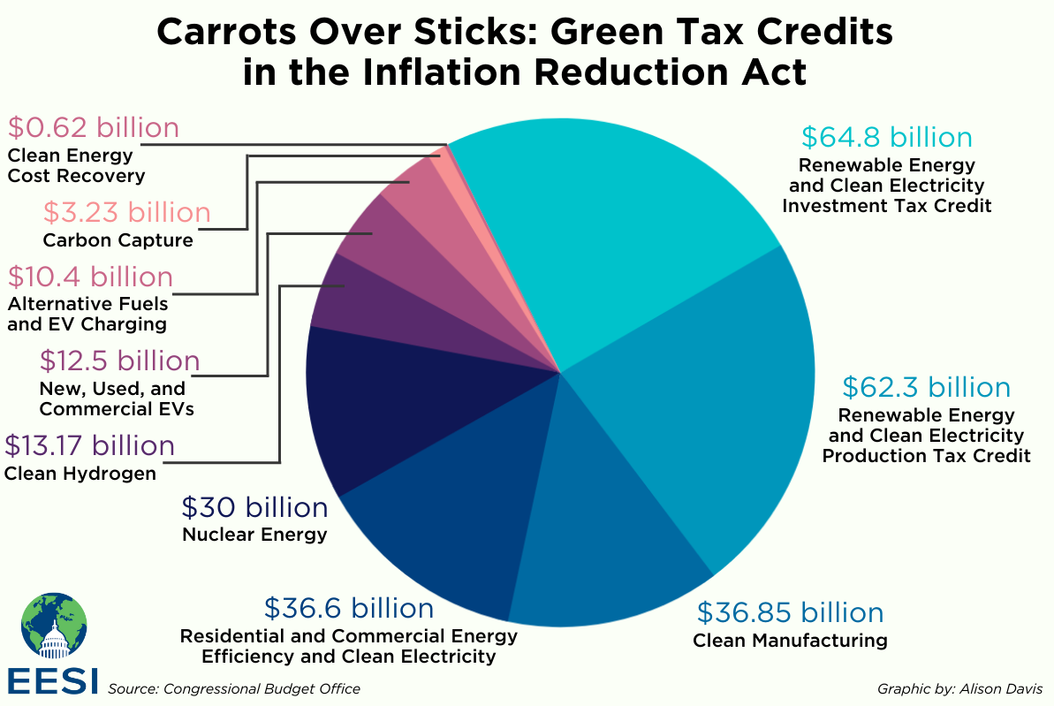
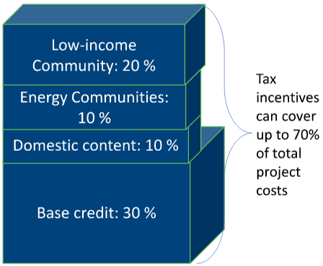
Other Funding Opportunities for J40 Communities

Slide 17
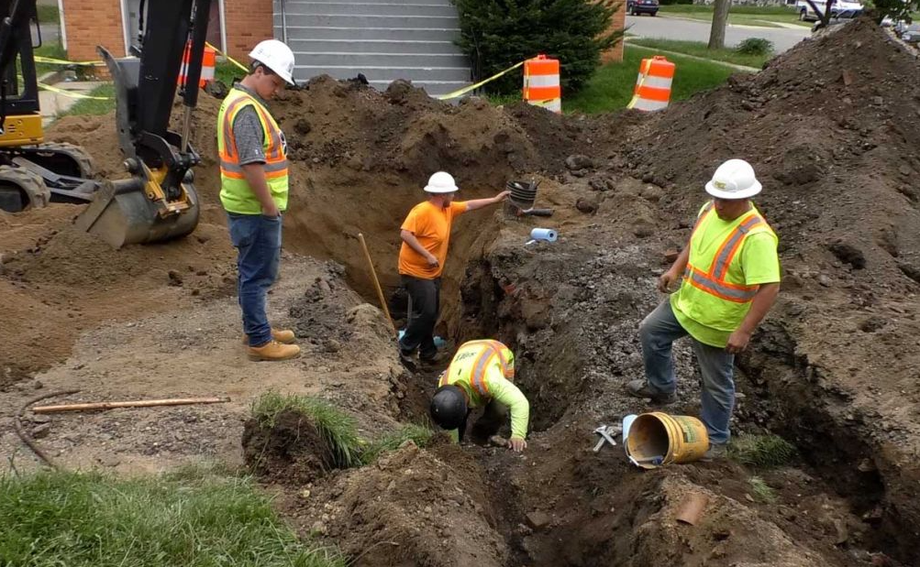
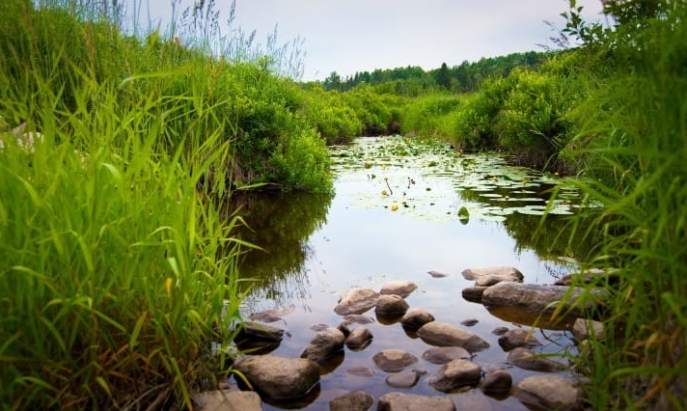
Questions?
Kate Madigan
kate@madiganstrategies.com

Slide 18
Breakouts
Notes:
Present your findings from the homework (identifying eligible census tracts in your municipality)
How do the priorities of those census tracts align with Justice40 opportunities?
What would a project look like?

Slide 19
Breakouts
Common grant questions
Where is the impacted community? (from homework)
What challenges do they face?
How does the proposed project help them address these?
What community partners can help make this project more successful?

Slide 20
Breakout Rooms
Discuss your answers with your group
Review your homework activity
Work through the activity together here
Reference: session one activity

Slide 21
Share Out
Each group share one suggested project, how you determined community need, and how you determined project partners.

Slide 22
Closing
Recap webinar
What’s next?
Session three, June 27, 2024
Homework
Work through the Justice40 Worksheet

Slide 23
Thank You!

