Slide 1
Justice40 Capacity Building Cohort
Session Three
June 27, 2024

Slide 2
Agenda
Introductions
Helpdesk
Breakouts
Review homework assignment
Technical assistance roundtable
Next steps
Survey

Slide 3
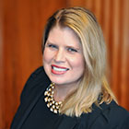
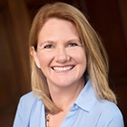
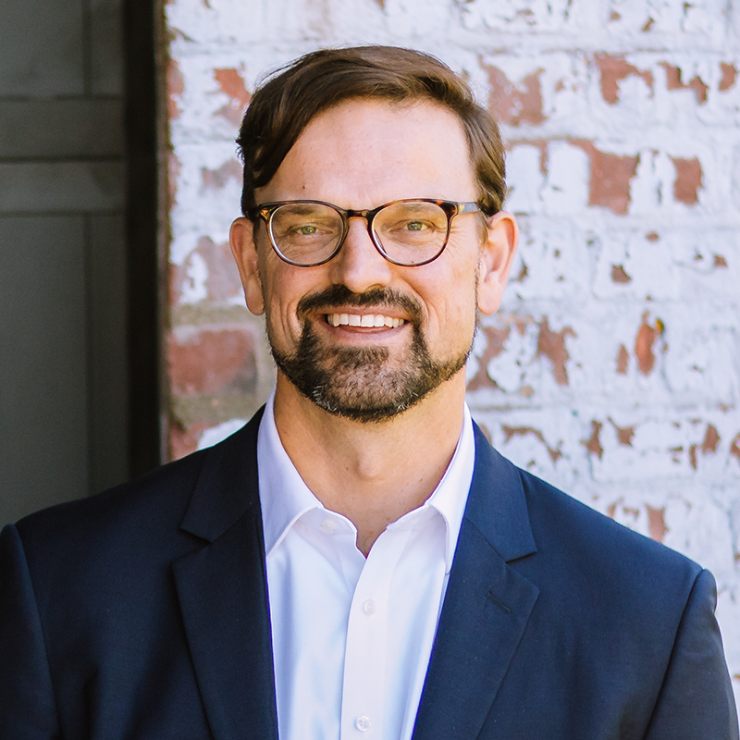
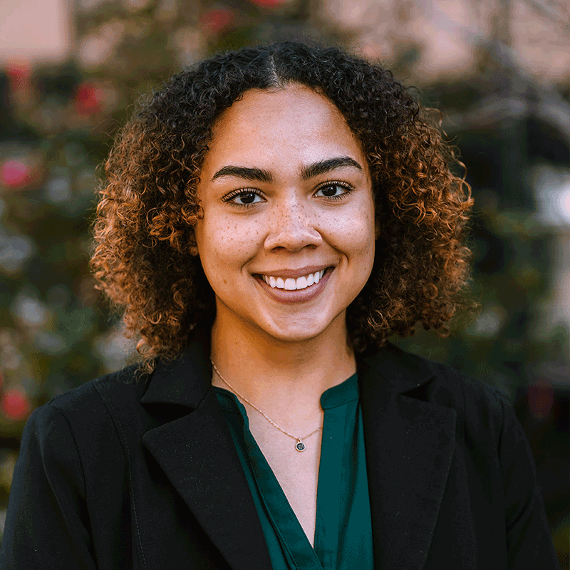
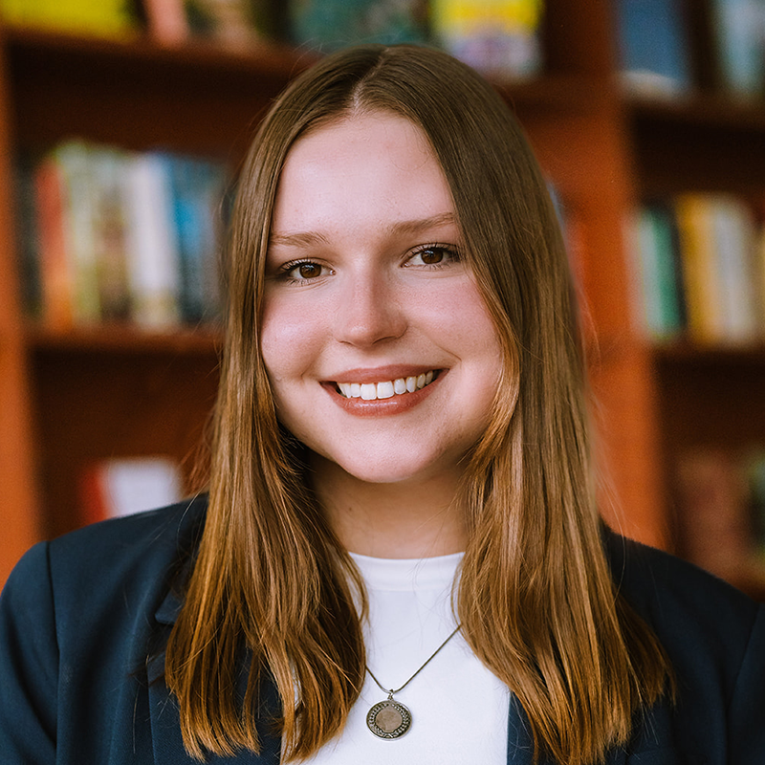
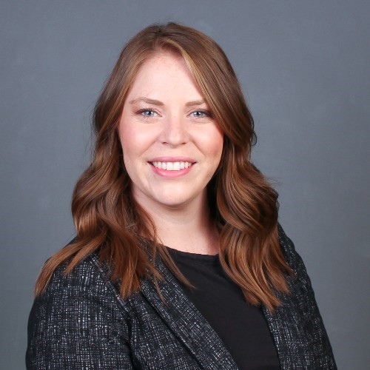
Introductions
Michigan Municipal League
Public Sector Consultants
OHM Advisors
Melissa Milton-Pung,
Program Manager
Shanna Draheim, Director of Policy
Lydia Schaafsma, Program Associate
Joel Howrani Heeres, AICP,
Director of Community Resilience
Brianna Pagel, Executive Assistant
Meagan O’Brien, Consultant
Madison Merzlyakov, Client Representative
Notes:
Icebreaker:

Slide 4
Technical Assistance
helpdesk@mifundinghub.org
Send a message to the Helpdesk email address. We will reply with an intake form and follow-up questions.
Fill out the intake form and we’ll coordinate a time to meet virtually.
Talk to our grant experts to discuss funding gaps and opportunities. This meeting is usually 30–45 minutes long.
Receive follow-up support as needed. This support may include the Helpdesk searching for additional funding opportunities or peer reviewing your funding applications.
Notes:
Hand back to Joel

Slide 5
Breakouts
Notes:
Present your findings from the homework (identifying eligible census tracts in your municipality)
How do the priorities of those census tracts align with Justice40 opportunities?
What would a project look like?

Slide 6
Breakouts
Review Justice40 worksheet with groups
Present and provide constructive feedback to each other
Describe a project your community is working on or you would like to see happen
What are the challenges that might arise in implementing this project?

Slide 7
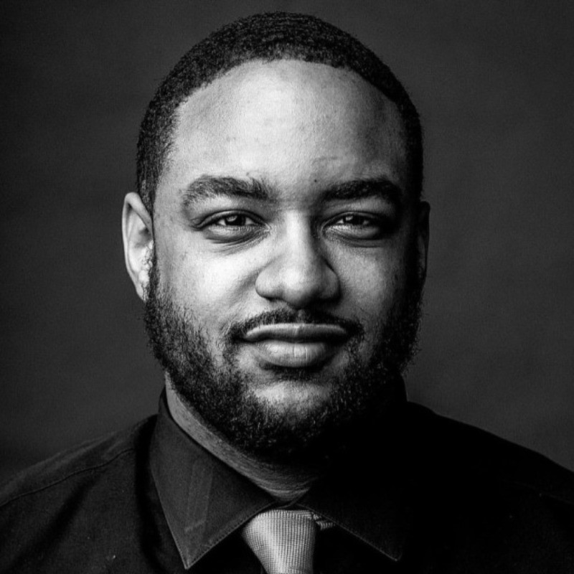
Technical Assistance Providers
Jonathon “Trey” Scott
Regional Director
Blacks in Green Justice Thriving Communities Technical Assistance Center
Kate Madigan
Climate and Energy Consultant
Madigan Consulting and 5 Lakes
Madison Merzlyakov
Client Representative
MI Funding Hub Helpdesk- OHM Advisors
Notes:
Kris Brady
Director
Michigan Infrastructure Office Technical Assistance Center
Prior to joining the Michigan Infrastructure Office to establish the Technical Assistance Center, Kris Brady served northern Michigan communities for 30 years providing technical assistance including: Needs Assessment, community development master planning, creating community teams to address identified needs, writing strategic plans, identifying funding (federal,state,local),grant writing and administration, program management to completion. Also, through her directorship at Northwest Michigan Community Action, Brady served in leadership positions on statewide boards including the Michigan Homeless Policy Council, Michigan Interagency Council on Homeless, Community Economic Development Association of Michigan and HomeStretch Non-profit Housing Corporation. She is a founding member of the Northwest Michigan Coalition to End Homelessness, Rural Partners of Michigan, and Grand Traverse Area Homeless Youth Initiative. Kris is excited to have established the first MIO Technical Assistance Center and looks forward to utilizing her expertise and passion for service to help grow and build Michigan communities.

Slide 8
Technical Assistance (TA) RoundTable
Meet with TA providers and learn about their programs
Speed Dating Style
Every group will spend 8 minutes with each provider.

Slide 9
Local Infrastructure Hub Regional Cohorts Program Introduction
June 2024

Slide 10
Local Infrastructure Hub Breakdown
Funders
Bloomberg Philanthropies
Waverly Street Foundation
Ford Foundation
Regional Hub Coordinating Organizations
Elevate (Midwest)
Southeast Sustainability Director’s Network (Southeast)
Project Coordination and Regranting
Sustainable Cities Fund at the New Venture Fund
Consulting Partners
Thomas Consulting Group
City Scale

Slide 11
Program Overview
Direct support and "deep" technical assistance to communities in pursing federal funding
Eligible cities are those with black leadership or roughly 30% or greater black population
Exclusive to supporting climate and equity projects
Notes:
The Local Infrastructure Hub is a national program designed to connect cities and towns with the resources and expert advice they need to access federal infrastructure funding in order to drive local progress, improve communities, and deliver results for residents.

Slide 12
Program Goal
To partner with communities in funding climate and equity priorities with federal and state grants

Slide 13
Program Services
Community Engagement
Multi-stakeholder engagement
Project Development
Grant Application Support
Preliminary planning
Support community planning processes
Process and project mapping
Technical support
Grant writing
Feasibility studies and analysis
Notes:
Providing technical assistance to local communities and municipalities to help them obtain federal grants for climate and equity projects
Identifying, launching, and coordinating city engagement
Coordinating with networks for outreach and amplification

Slide 14
Eligible Locations
Notes:
Illinois, Indiana, Kansas, Kentucky, Michigan, Minnesota, Ohio, Wisconsin

Slide 15
Contact information
Brooke Kersten
Brooke.kersten@ElevateNP.org

Slide 16
Closing
Recap webinar
What’s next?
Continue to pursue grants
Hone grant language
Connect with TA providers
Survey

Slide 17
Thank You!

