Slide 1
Welcome!
September 26, 2024

Slide 2
Helping Michigan municipalities navigate new state and federal funding opportunities
Funding support provided by the Michigan Department of Labor and Economic Opportunity; the Michigan Municipal League (MML) team is available now to help communities understand and successfully pursue state and federal recovery and infrastructure funding.

Slide 3
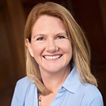
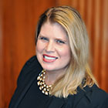
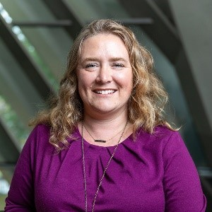
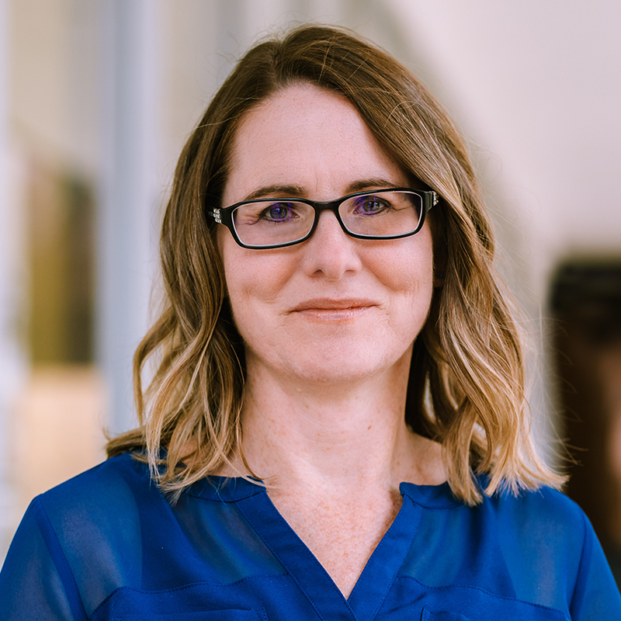
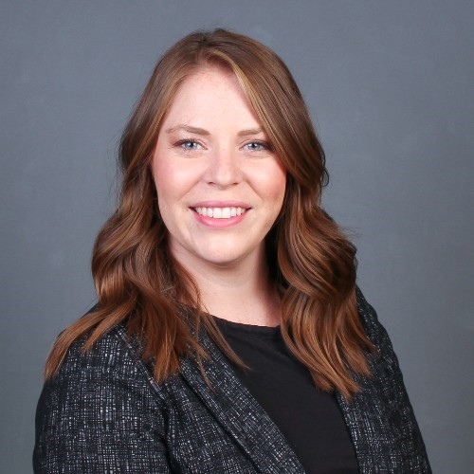
Team Introductions
Michigan Municipal League
Public Sector Consultants
OHM Advisors
Shanna Draheim, Director of Policy Research Labs
Melissa Milton-Pung,
Program Manager
Julie Durham,
Director
Aimee Cain, Content and Event Specialist
Madison Merzlyakov, Client Representative
MC Moritz, Project Engineer

Slide 4
Polling Activity
Notes:
1. What type of community are you representing today?
Rural
Urban
Suburban
Other
2. What are your community’s top two funding priorities of the following?
Workforce development
Capacity building
Infrastructure development
Land-based industry business development

Slide 5
Agenda
MI Funding Hub overview
Feedback requested
Technical assistance
Guest speakers
Henry Wolf, Office of Rural Prosperity
Tracey Barnes, Michigan Department of Agriculture and Rural Development
Grant basics: Building a strong grant team
State grant updates
Recap and adjourn

Slide 6
MI Funding Hub Review
Community eligibility
Database of federal and State of Michigan grants​
Technical assistance
Capacity building
Articles, toolkits, and other resources​
Ongoing newsletter and webinars
Justice40 capacity building

Slide 7
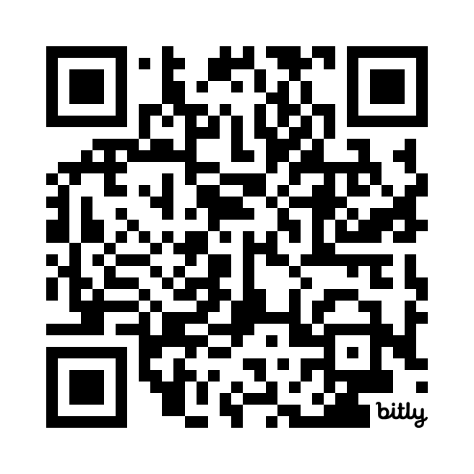
We want to hear from you!
Don’t be shy! Tell us what you think.
Your feedback is vital to the development of MI Funding Hub
Help us build the product to help you
Alternatively submit feedback via helpdesk@mifundinghub.org

Slide 8
Technical Assistance
helpdesk@mifundinghub.org
Send a message to the Helpdesk email address. We will reply with an intake form and follow-up questions.
Fill out the intake form and we’ll coordinate a time to meet virtually.
Talk to our grant experts to discuss funding gaps and opportunities. This meeting is usually 30–45 minutes long.
Receive follow-up support as needed. This support may include the Helpdesk searching for additional funding opportunities or peer reviewing your funding applications.

Slide 9
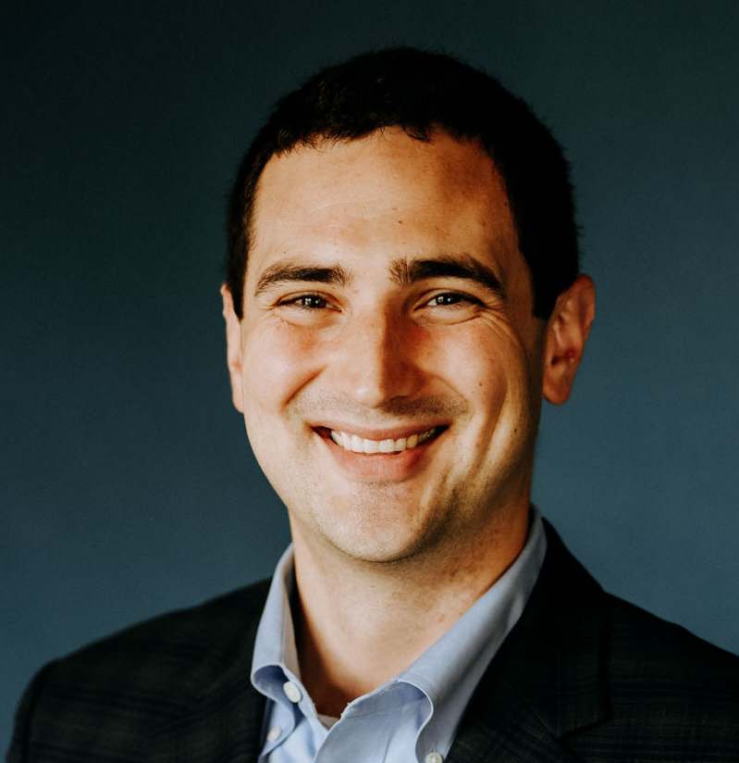
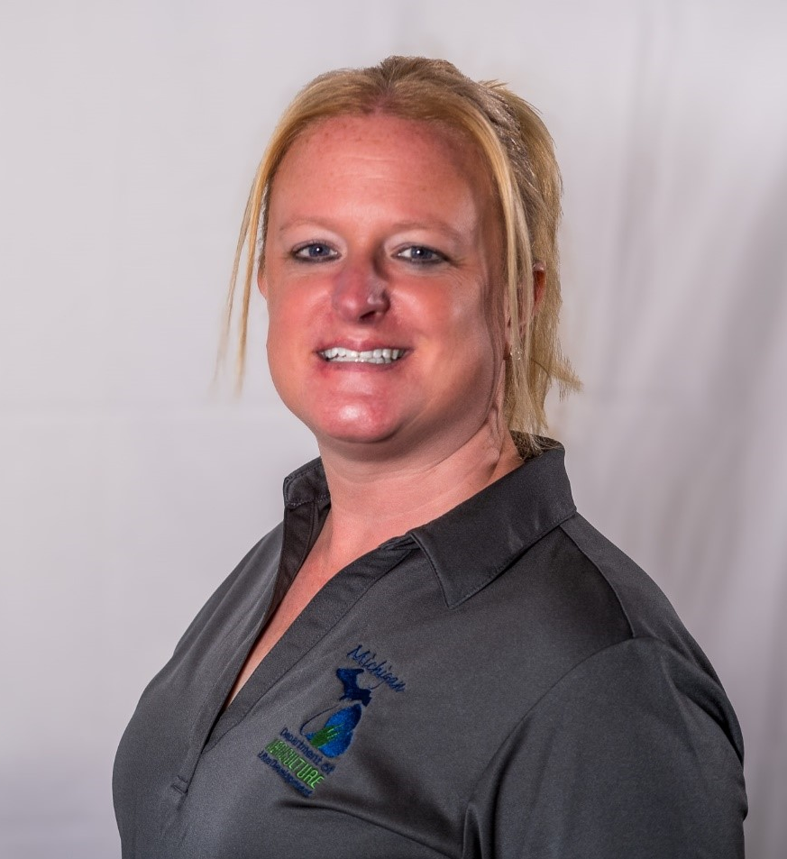
Guest Speakers
Henry Wolf
Director of Policy and Grant Programs
Office of Rural Prosperity
Department of Labor and Economic Opportunity
Tracey Barnes
Grants Program Manager
Department of Agriculture and Rural Development

Slide 10
A An intergovernmental and cross-sector liaison and “front door” for rural communities
Strategize and advocate for rural needs in policy and program decisions
Help rural communities navigate to partners and resources
Build a strong rural network to keep rural communities connected to each other and resources

Slide 11
Rural Readiness grants are building a pipeline of projects and plans that will add housing, health access, infrastructure, grant-writing capacity, nonmotorized infrastructure, child care, and more
A growing rural network is fostering connections, partnerships, and funding opportunities
Feedback from thousands of rural residents and leaders is informing statewide strategies, policy changes, and funding programs
Notes:
In 2023, the ORP developed and launched the Rural Readiness Grant Program, awarding over 40 grants to communities and regions across Michigan for planning and capacity-building initiatives. The grants are building pipelines of housing projects, funding grant writing capacity, housing plans and needs assessments, behavioral health initiatives, nonmotorized transportation initiatives, childcare programming, comprehensive emergency response planning, and more. The Rural Readiness Grant program was designed in direct response to needs persistently identified by rural communities: with flexible funding that can address an array of rural priorities, the program feature a simple application process, the program also featured rural-specific scoring and eligibility criteria, targeting communities with greater need as demonstrated by income, population change, and capacity limitations. With over $9 million in funding requests for $1.85 million in funding, the ORP worked to support all projects by offering one-on-one support to connect applicants to technical assistance and appropriate funding opportunities, working with state agencies and philanthropies to identify additional funding opportunities for Rural Readiness Grant applicants.

Slide 12
Successful communities invest in planning and collaborate across sectors
Rural communities have unique and valuable assets that can be activated and leveraged
Regional perspectives, solutions, and collaboration can help to overcome geographic and capacity barriers
Investment requires organizational capacity and infrastructure

Slide 13
Housing is consistently identified as a top challenge – often ‘the’ top challenge
Rural Readiness Grant Program
Develop shovel-ready projects
Encourage cross-sector, multi-jurisdictional partnerships and collaboration
Engage and support communities with limited capacities, incomes, and budgets
Prepare communities for long-term solutions and funding opportunities
Support partnerships, infrastructure, processes, and capacity that result in more resilient and vibrant rural communities

Slide 14
Rural Readiness Grant Program:
Eligible Activities
Cross-Sector Collaboration
Community and stakeholder engagement that fosters planning and dialogue across sectors, governments, and agency types.
Development Readiness
Activities that prepare communities or key properties for development or investment, including development of property inventories, site development studies, land assembly activities, feasibility or market studies, and more.
Partnerships and Planning
Development of plans and implementation structures that build readiness for future projects, collaborative initiatives, development, and investment.
Rural Capacity Building
Fellowship programs or community-based internship programs, leadership development programs, and shared services or staff dedicated to specific project or planning needs. Projects must demonstrate an innovative, collaborative approach to building long-term capacity.

Slide 15
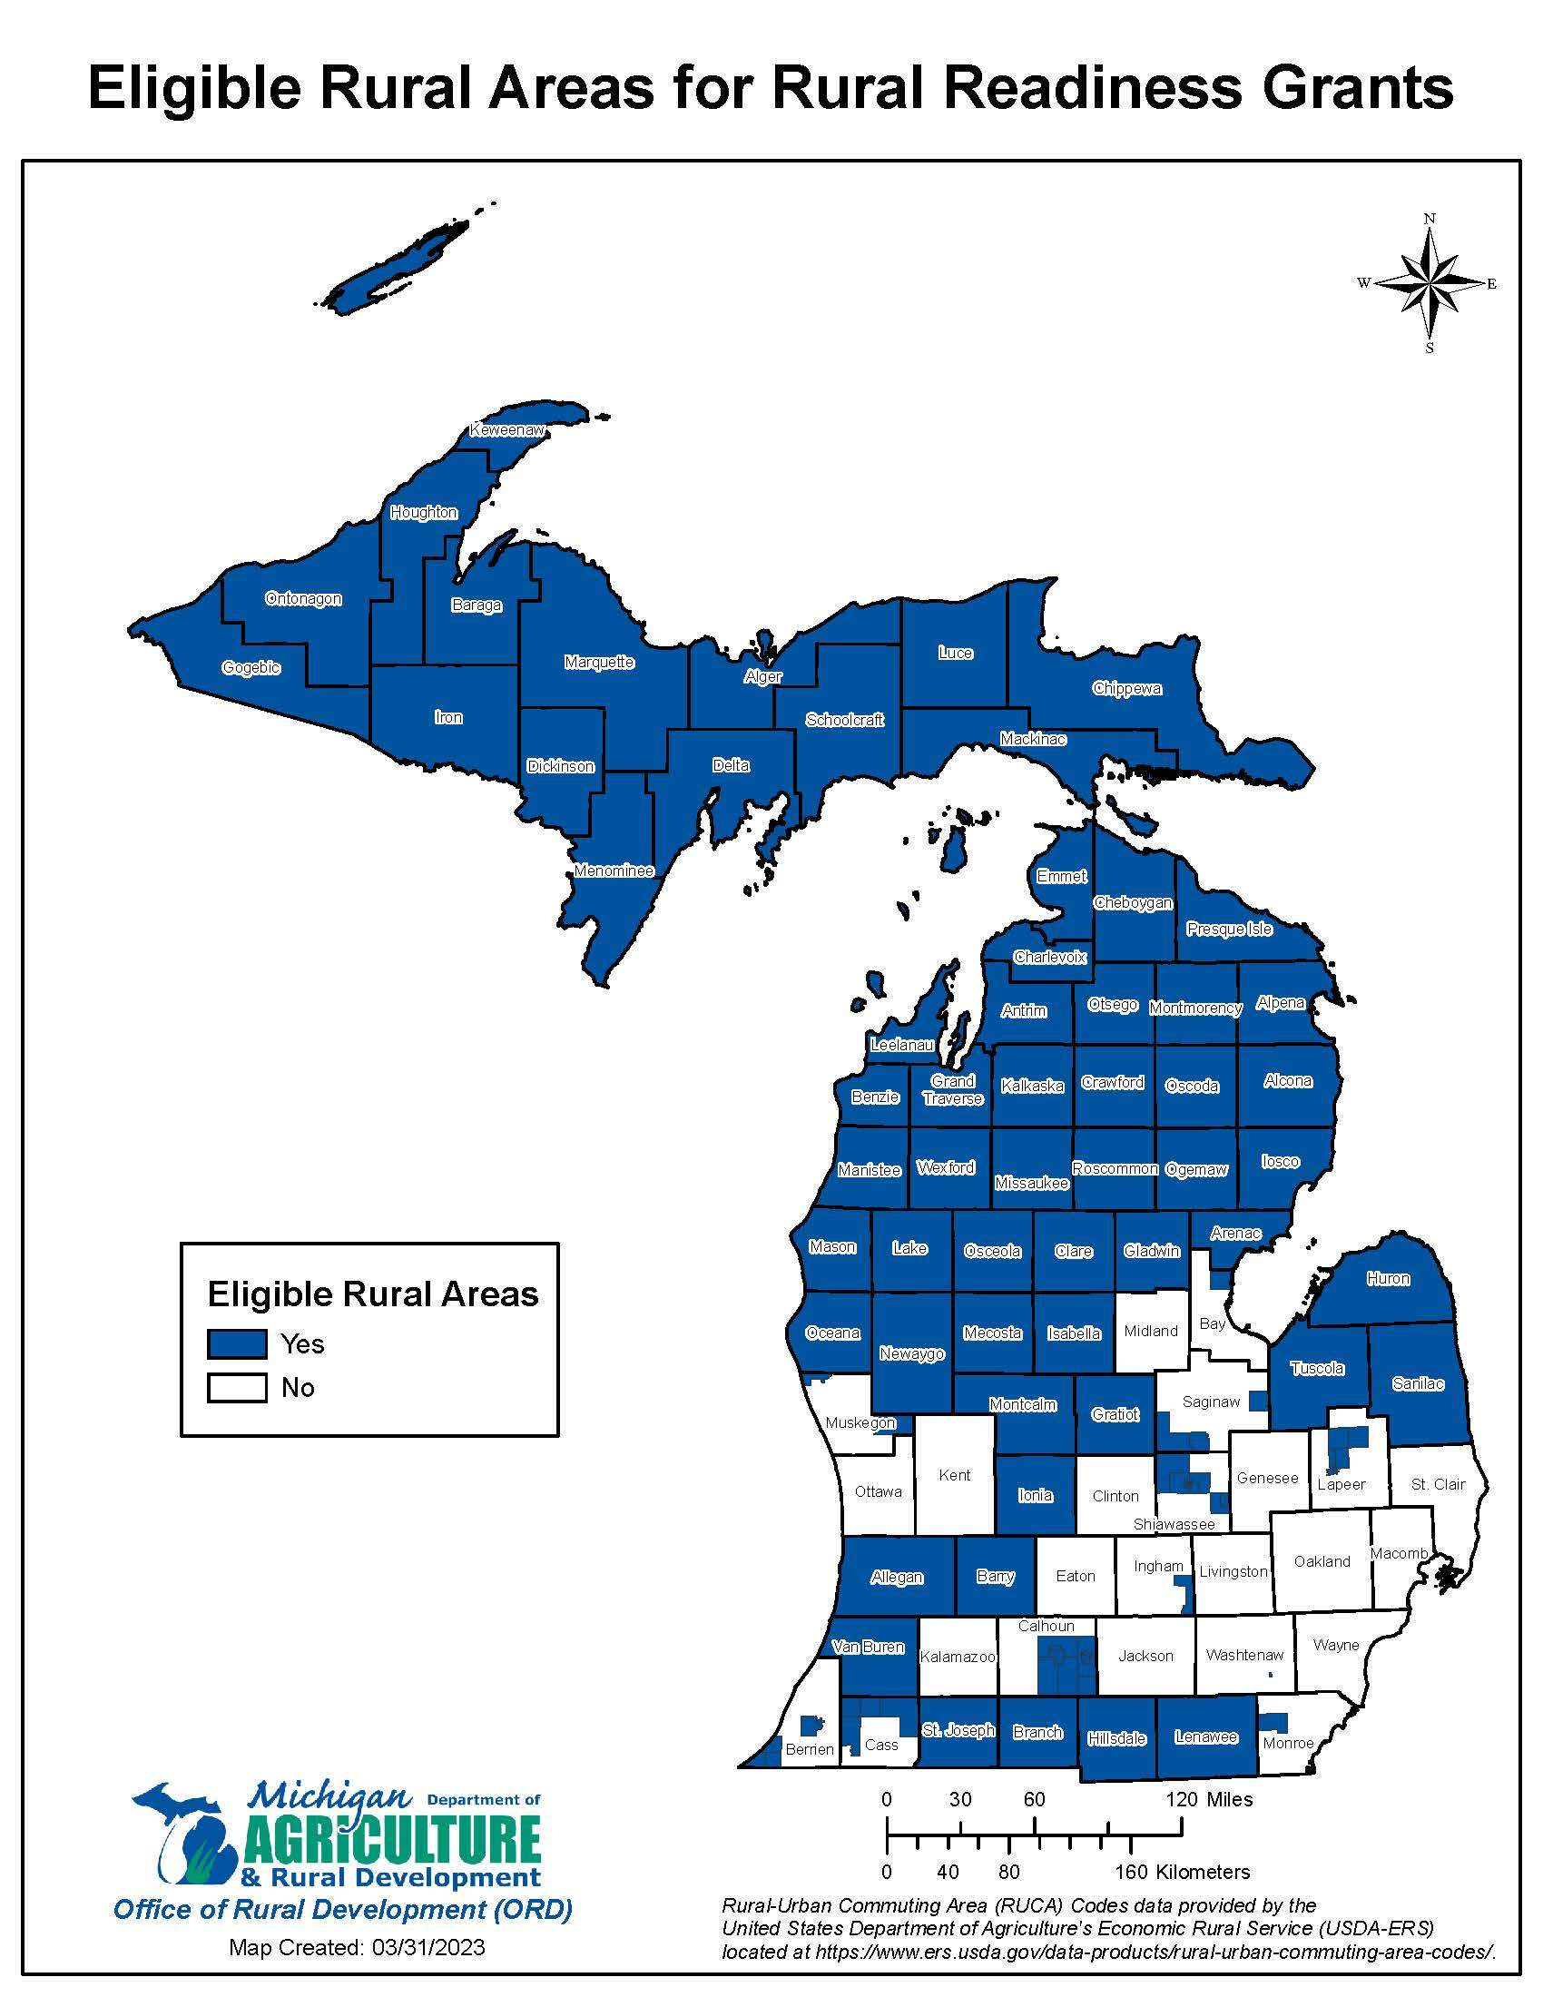
Rural Readiness Grants
Eligible Rural Areas
Nonmetropolitan counties, including micropolitan statistical areas
Census tracts with rural-urban commuting area (RUCA) codes between 4 and 10
Map and list of eligible counties and census tracts available online at:
www.michigan.gov/leo/-/media/Project/Websites/leo/Documents/ord/RRP-Round-3/Round-3-RRGP-Eligible-Rural-Areas-Definition-and-List.pdf
Notes:
NOTE: This map is available in our grant guidelines and we can drop them in the webinar chat.

Slide 16
Office of Rural Prosperity
Rural Readiness Grant Program​
​
Eligible Counties
Eligible Census Tracts
In addition to rural counties, census tracts with RUCA codes between 4 and 10 are considered rural areas in the following metropolitan counties (see attached list of eligible rural areas and map for eligible census tracts):
Alcona | Charlevoix | Grand Traverse | Keweenaw | Menominee | Otsego
Alger | Cheboygan | Gratiot | Lake | Missaukee | Presque Isle
Allegan | Chippewa | Hillsdale | Leelanau | Montcalm | Roscommon
Alpena | Clare | Houghton | Lenawee | Montmorency | St. Joseph
Antrim | Crawford | Huron | Luce | Newaygo | Sanilac
Arenac | Delta | Ionia | Mackinac | Oceana | Schoolcraft
Baraga | Dickinson | Iosco | Manistee | Ogemaw | Tuscola
Barry | Emmet | Iron | Marquette | Ontonagon | Van Buren
Benzie | Gladwin | Isabella | Mason | Osceola | Wexford
Branch | Gogebic | Kalkaska | Mecosta | Oscoda
Bay | Monroe
Berrien | Muskegon
Calhoun | Saginaw
Cass | Shiawassee
Ingham | Washtenaw
Lapeer
Statewide organizations are also eligible to apply for projects as long as the project serves one or more eligible rural areas.

Slide 17
Eligible Applicants
Office of Rural Prosperity
Rural Readiness Grant Program​​
Tax-exempt organizations/nonprofits, including community foundations and statewide associations
Local units of government, intermediate school districts (ISDs) and regional educational service agencies (RESAs)
Federally recognized tribes
Educational institutions, including universities and community colleges
Regional planning agencies and economic or workforce development organizations

Slide 18
Application Process: Letter of Intent
Office of Rural Prosperity
Rural Readiness Grant Program​
A letter of intent is required before grant applications will be accepted.
A letter of intent determined to be eligible and competitive for grant funding will be invited by the ORP to submit a full grant application.
Letters of intent must be submitted via email to WolfH@michigan.gov by 3:00 p.m. (EDT) on Monday, October 7, 2024 and will include:
Applicant/co-applicant information
Type of project
Brief description of project (including location)
Total project cost and sources of match
Notes:
The LoI must contain a basic summary of the proposed project, how the proposed project meets the ORDs Rural Readiness Grant goals, and a total estimated project cost.
The confirmation emails are manually sent, so you will not receive an instant confirmation. If you do not receive a confirmation of receipt from our office within 48 hours, please call 517-927-5847, or e-mail WiitalaM@michigan.gov.

Slide 19
Budgeting and Match
Office of Rural Prosperity
Rural Readiness Grant Program​​
The maximum limit on grant fund requests is $50,000.
Applicants must provide a 20% match. The match is 20% of the grant amount requested (e.g., if you are requesting $50,000, the minimum match must be at least $10,000).
Match can be cash, in-kind, or a combination thereof.
Previous awardees must provide a 30% match for projects that build on previous RRGP success.
Overmatch is encouraged.
Notes:
RE: size of documents: emphasis here is that this is just a two page document. The Letter of Interest form itself and grant guidelines will be dropped in the webinar chat.

Slide 20
Letter of Intent & Application Timeline
Office of Rural Prosperity
Rural Readiness Grant Program​
​
Monday, October 7
Letter of intent due
Week of November 11
ORP will issue invitations to submit full grant applications. All applicants will receive guidance as to the status of their Letter of Intent and project resources regardless of invitation status.
Monday, December 9
Full applications due
Week of February 3, 2025
Grant awards announced
Application
Timeline
Notes:
RE: size of documents: emphasis here is that this is just a two page document. The Letter of Interest form itself and grant guidelines will be dropped in the webinar chat.

Slide 21
Thank you!
@MIDeptLEO
@MichiganLEO
@MichiganLEO
@MichiganDeptofLaborandEconomicOpportunity
Linkedin.com/company/michiganleo
LucasS5@michigan.gov
517-331-7181
WolfH@michigan.gov
517-927-5847

Slide 22
Food and Agriculture Business Development Grant Programs
Tracey Barnes, Grants Program Manager
Grants Team
Food and Agriculture Business Development Division

Slide 23
2024 MDARD Grant Programs
Rural Development Fund
Underserved, Value Added, Regional Food Systems and Underserved Food and Agriculture Business
Food and Agriculture Investment Fund
Wastewater Infrastructure Fund

Slide 24
Rural Development Fund
Purpose
This grant opportunity is for projects that address expansion and sustainability of land-based industries:
Food and agriculture, forestry, mining, oil and gas, and tourism.
Funding focused on infrastructure development, rural capacity building, business development, and talent development and training. This can include:
Worker training related to land-based industries, energy, livestock processing, transportation, housing, communications, broadband, water and wastewater infrastructure to benefit rural communities and micropolitan statistical areas
Timeline
RFP opens in October 2024

Slide 25
Rural Development Fund
Project Type​ | Examples of Funded Projects​
Infrastructure development | Roadways, bridges, renewable energy, wastewater, rural housing, broadband, etc. ​
Rural capacity building | Museums, local and regional tourism campaigns, feasibility studies, etc. ​
Business development | Business expansion ensuring long-term creation or retention of jobs with a strong local and/or regional impact. ​
Talent development and training | Local and regional workforce development programs, workforce training, rural housing projects, child care, etc.​

Slide 26
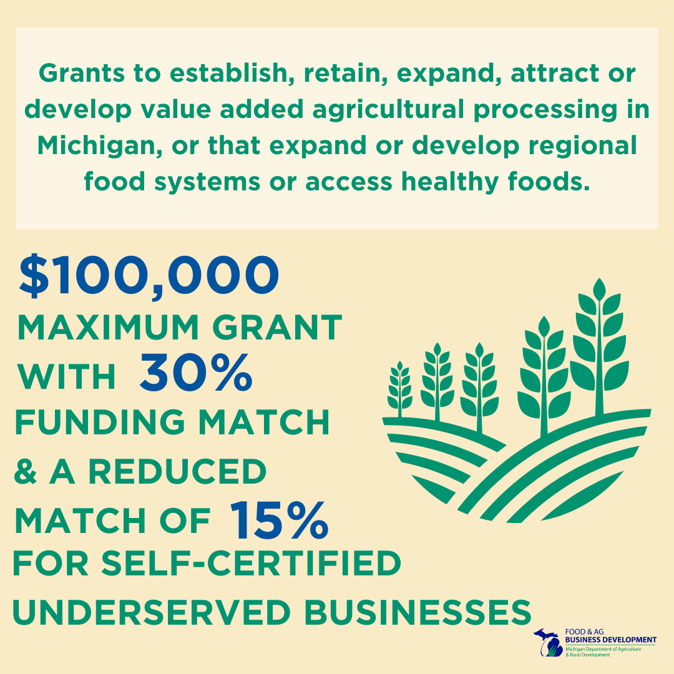
Underserved, Value Added, Regional Food Systems and Underserved Grant
Purpose
Aimed to promote the expansion of value-added agriculture production, processing, and access within the state to enhance Michigan’s food and agriculture industry and designed to build capacity and readiness for underserved food and agriculture businesses across Michigan. Funding focused on value-added food processing, food hubs and food access for business with capacity building initiatives.
Open to individuals, organizations, businesses, local units of government, federally recognized tribes, and educational institutions. 30% match on each proposal with a reduced match of 15% for self-certified underserved businesses.
Timeline
RFP will be announced in September 2024

Slide 27
Value Added and Regional Food Systems
Project Type​ | Examples​ of Funded Projects
Food hub development | Feasibility studies ​ ​Expansion of capacity, including equipment, cold storage,​marketing, etc. ​Training and education for Michigan growers ​
Food access, including access to fresh/nutritional foods | Development of educational resources about Michigan-grown food and commodities​ ​Feasibility studies around food resources ​Expansion of projects in food-insecure regions
Value-added food processing | Innovation and equipment ​Technical assistance, including feasibility studies that lead to jobs/investment ​Outreach and training

Slide 28
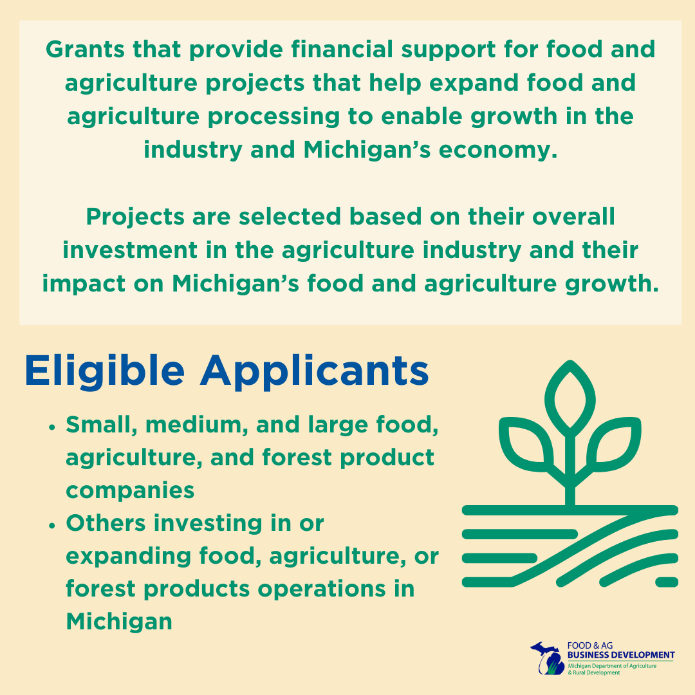
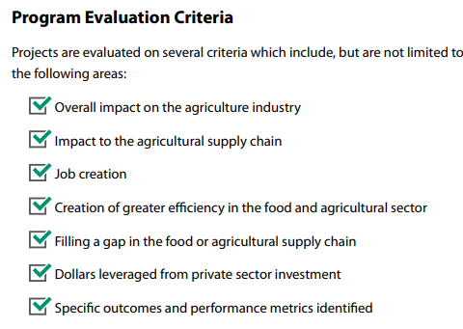
Food and Agriculture Investment Fund

Slide 29
Food and Agriculture Investment Fund
Examples​ of Funded Projects
Making critical upgrades in equipment to manufacture ice cream ​​Purchasing of equipment to support processing for Michigan’s fruit industry​
Constructing a state-of-the-art indoor agriculture greenhouse and warehouse ​Developing a food innovation center
Expanding a meat processing facility​ ​Supporting the development of a local flour mill to create value-added processing for regional market expansion

Slide 30
Wastewater Infrastructure Fund
Criteria and Eligibility​
The grant is open to existing agriculture and food processors located in Michigan, who are under an Administrative Consent Order, compliance and enforcement action, and have a Schedule of Compliance found in a Certificate of Coverage or state Groundwater Discharge Permit from EGLE.
Eligible Investment Costs​
This grant will cover 50% of the eligible investment costs which range from prework, to engineering design, development of required permit plans, equipment, and installation. ​
Award Amount Available​
There is over $30 million in total funding available. Funding for this grant is based upon the daily wastewater flow in gallons per day and overall project investment. Funding ranges from $225,000 to $2 million.
Purpose​
MDARD is offering a grant opportunity in support of projects that address wastewater infrastructure needs within Michigan’s food and agriculture industry.​
Goals of the Program​
MDARD is assisting the food and agriculture industry to ensure compliance with Michigan Department of Environment, Great Lakes and Energy (EGLE) wastewater regulations under the Groundwater Discharge Program, helping them move toward climate-smart practices that will protect the environment and public health.

Slide 31
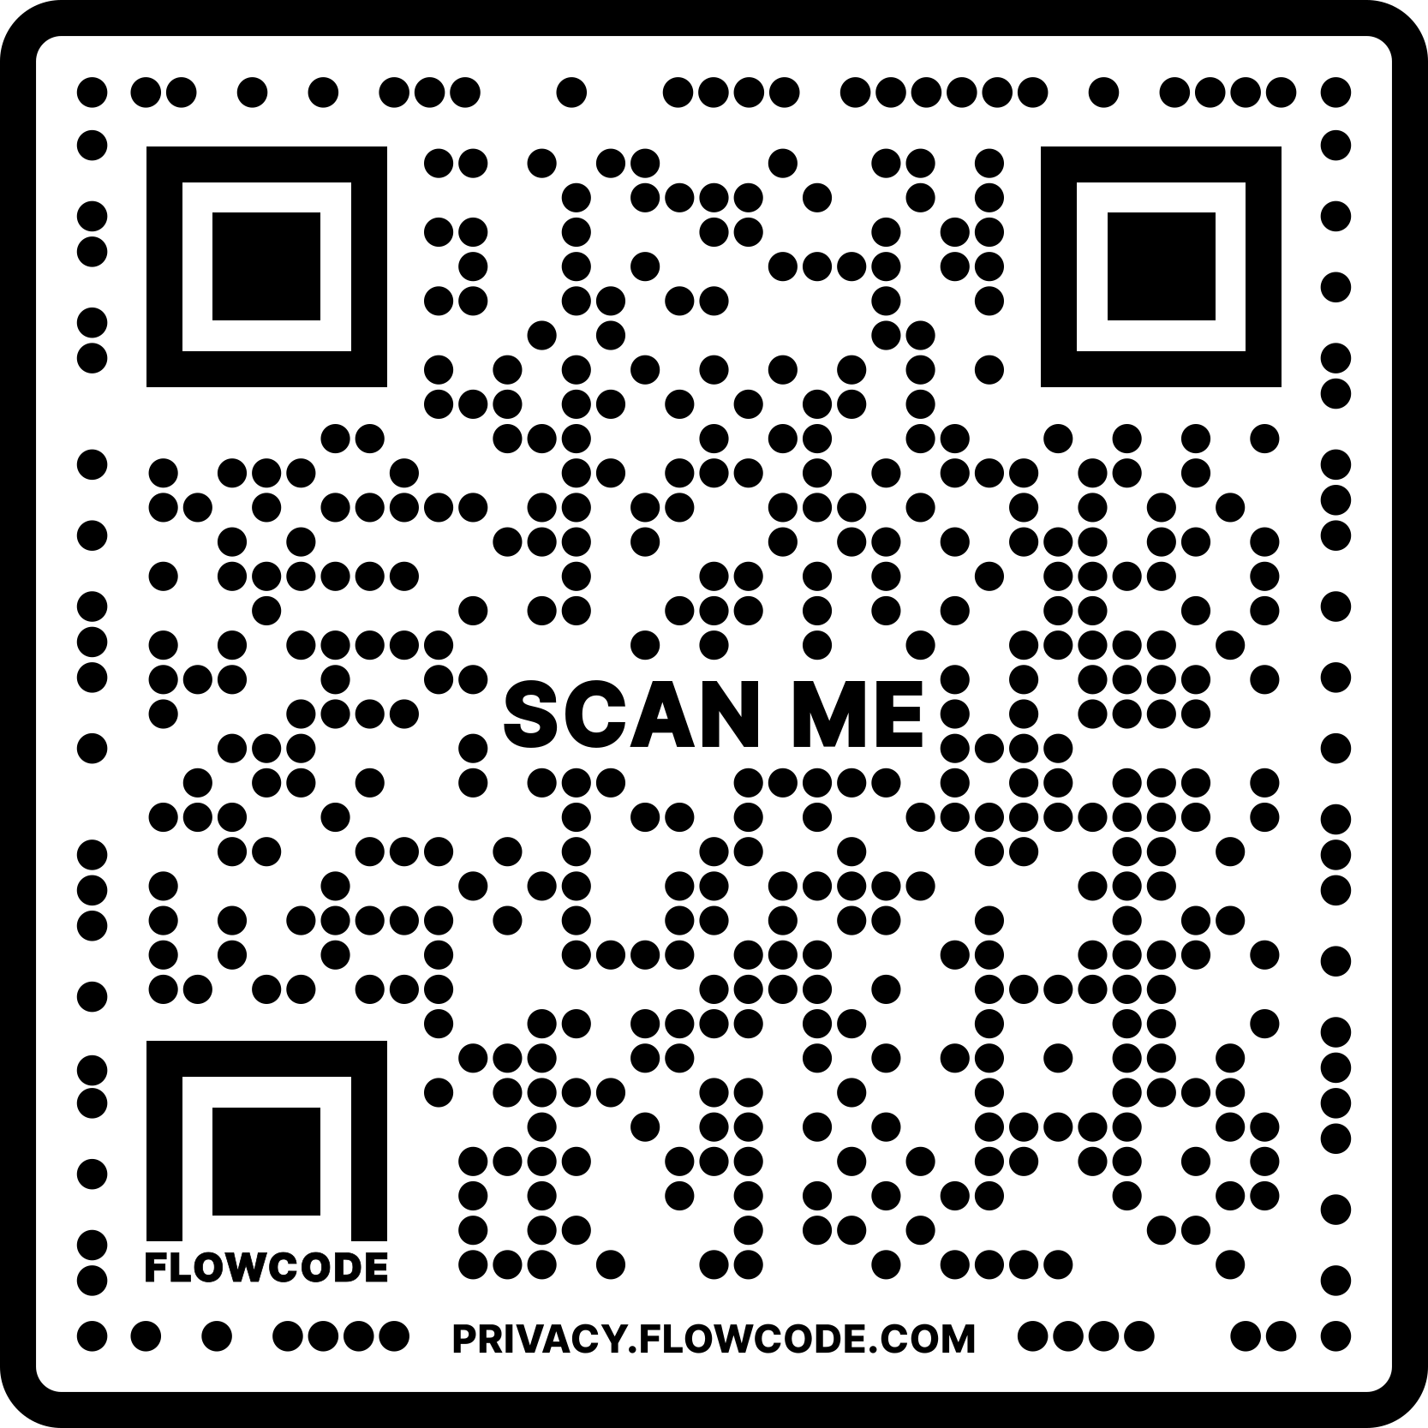
Thank you!
@MichDeptofAg
www.michigan.gov/mdardgrants
mda-grants@michigan.gov
Get personalized voter information on early voting and other topics at Michigan.gov/Vote.

Slide 32
Q&A

Slide 33
Grant Basics
Building a Strong Grant Team
Grant writer
Finance and budget director
Program staff
Leadership

Slide 34
State Grant Updates
Don’t forget about these …
Community Energy Management
Extended deadline to December 31, 2024
Renewables Ready Communities
Extended until funds are exhausted

Slide 35
Closing
What’s Next?
October 24, 2024, webinar
Continuously adding grants to the database
Helpdesk will continue to provide support
New and improved Justice40 resources

Slide 36
Contact Us
Helpdesk email
helpdesk@mifundinghub.org ​
Sign up for monthly newsletters
https://mml.org/programs-services/mifundinghub/signup/

Slide 37
Thank you!

