Slide 1
Welcome!
October 24, 2024

Slide 2
Helping Michigan municipalities navigate new state and federal funding opportunities
Funding support provided by the Michigan Department of Labor and Economic Opportunity;
the Michigan Municipal League (MML) team is available now to help communities understand and successfully pursue state and federal recovery and infrastructure funding.

Slide 3




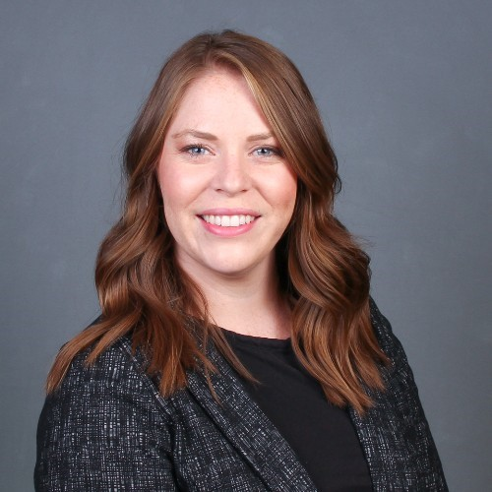

Team Introductions
Michigan Municipal League
Public Sector Consultants
OHM Advisors
  Shanna Draheim, Director of Policy Research Labs
  Melissa Milton-Pung,
  Program Manager
  Julie Durham,
  Director
  Meagan O’Brien, Consultant
  Madison Merzlyakov, Client Representative
  MC Moritz, Project Engineer

Slide 4
Polling Activity

Slide 5
Agenda
MI Funding Hub Review
Technical assistance
Guest speakers
  Tim Klont, Michigan State Housing Development Authority
  Alan Higgins, State Historic Preservation Office
  Bryan Lijewski, State Historic Preservation Office
Grant basics
Upcoming grant deadlines
Recap and adjourn

Slide 6
MI Funding Hub Review
Community eligibility
Database of federal and State of Michigan grants​
Technical assistance
Capacity building
Articles, toolkits, and other resources​
Ongoing newsletter and webinars
Justice40 capacity building

Slide 7

Technical Assistance
Submit a request via the Helpdesk at: mifundinghub.org/get-assistance/
We'll reach out to coordinate a time to meet virtually.
Talk to our grant experts to discuss funding gaps and opportunities. This meeting is usually 30–45 minutes long.
Receive follow-up support as needed. This support may include the Helpdesk searching for additional funding opportunities or peer reviewing your funding applications.

Slide 8



Guest Speakers
Alan Higgins
Grants Manager/Budget Specialist
State Historic Preservation Office
Michigan Economic Development Corporation
Bryan Lijewski
Architect Specialist
State Historic Preservation Office
Michigan Economic Development Corporation
Tim Klont
Chief Engagement & Strategy Officer
Michigan State Housing Development Authority

Slide 9
Moving Quickly to Address Michigan’s Housing Supply Shortage

Slide 10

Statewide Housing Plan
  In July 2022, set a five-year goal to produce 75,000 housing units.
  Michigan.gov/HousingPlan
Notes:
/Housing Plan: Statewide Housing Plan, Regional Action Plans, and regionally-specific quarterly progress reports.

Slide 11
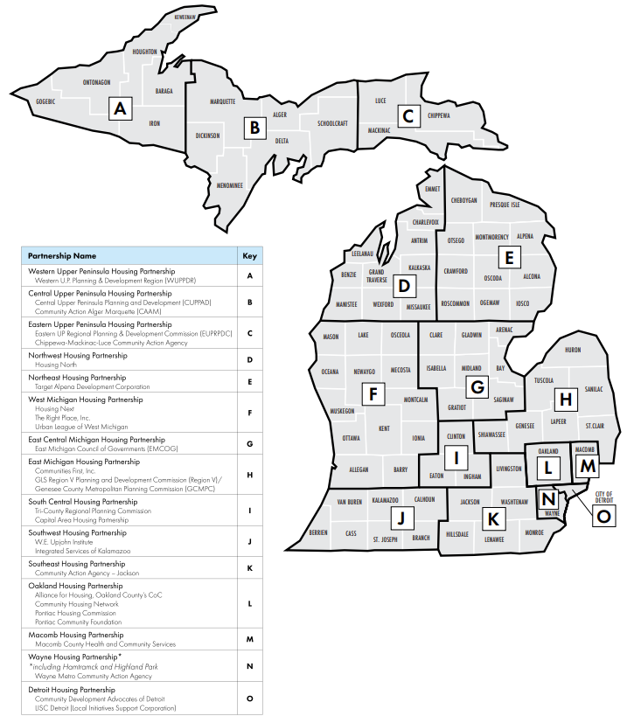
Regional
Housing
Partnerships

Slide 12
Tax Increment
Financing
Housing TIF (Tax Increment Financing)
Innovative, sustainable housing tool
Created by recent legislation (PA 381) that allows tax revenues captured through local brownfield redevelopment authorities to fund affordable housing costs with MSHDA approval
Funds:
  Creation or rehabilitation of rental or for-sale housing units for households below 120% AMI through Housing TIF reimbursement and financing
A MSHDA loan product can provide a financing option for developers seeking to leverage the TIF for eligible development costs
Notes:
How it works:
Allows housing development as an eligible activity for purposes of capturing taxes to assist with housing affordability
Starts with local approval of brownfield plan, then MSHDA review commences
A MSHDA loan product can provide a financing option for developers seeking to leverage the TIF for eligible development costs
Other benefits
Local control
Expands supply of housing in this range, which is critical for attracting and retaining talent and helping more people reach their full potential in Michigan
Will help Michigan transform underutilized or abandoned property into places of opportunity.

Slide 13
Housing Readiness
Incentive Grants
Support counties, cities, villages, and townships in adopting or eliminating rules and regulations to encourage building more housing and making housing more affordable.
Applicants may receive up to $50,000 to cover costs associated with changes to land use policies, master plan, zoning text, and similar activities. Work may be performed in-house or by consultants.
Municipalities will be categorized based on whether they have an MEDC designation as a Redevelopment Ready Community.

Slide 14
MI Neighborhood
Eligible Applicants:
    For- and nonprofit developers
    Local units of government
Eligible Activities:
    New construction, reconstruction, and rehabilitation
    Homebuyer, homeowner, and rental
Grants from $25,000 to $2,000,000
Consistency with regional action plan
Notes:
MIN-Policy-Update.pdf (michigan.gov)

Slide 15



MICHIGAN STATE HISTORIC PRESERVATION OFFICE
PRESERVATION GRANTS + INCENTIVIES
Alan Higgins, Grants Manager + Bryan Lijewski, FAIA, NCARB, Architect Specialist

Slide 16
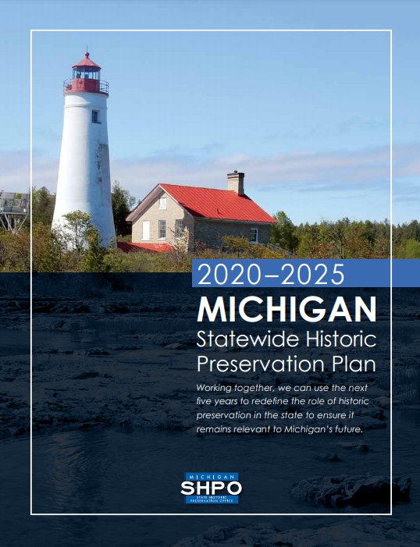
State Historic Preservation Office
The Michigan State Historic Preservation Office was established in the late 1960s following the passage of the National Historic Preservation Act of 1966.
Who We Are
Archaeologists
Architectural Historians
Historians
Historical Architects
Preservation Planners
Administrative Staff
What We Do
Michigan SHPO assists local communities, state and federal agencies, and other partners in their efforts to identify, evaluate, designate, protect, and tell the story of important places in Michigan’s history.

Slide 17
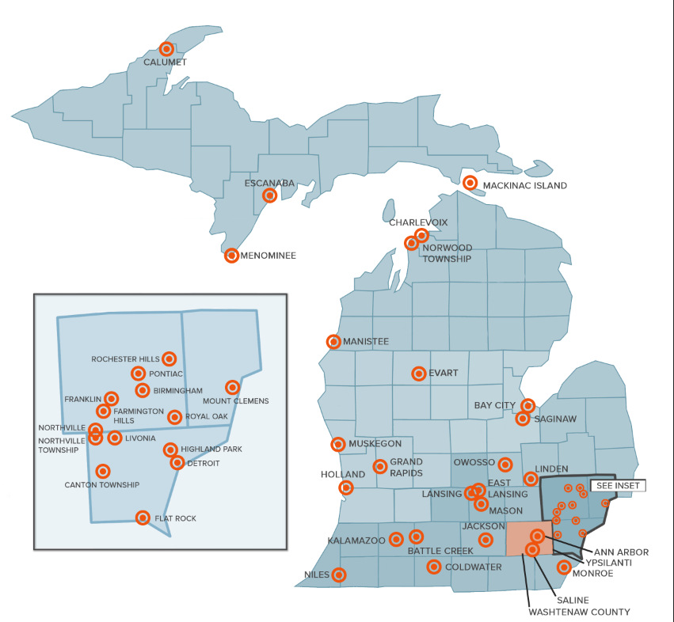
Certified Local Government Grants
What are they?
Funding from the National Park Service made available to SHPO to assist local communities in carrying out activities related to historic preservation
SHPO distributes via subgrants to eligible communities
Intended to support planning and educational activities, as well as rehabilitation of publicly owned historic properties
Who is eligible?
Communities that participate in the CLG program CLG = the local unit of government
CLGs may also elect to partner with a non-profit organization or other public entity

Slide 18
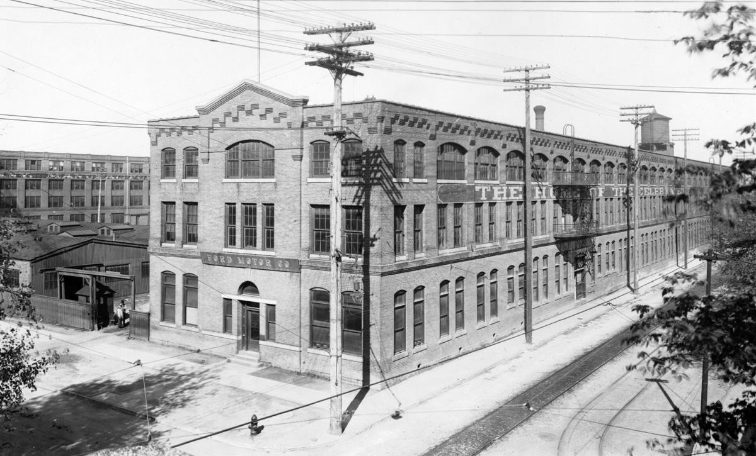
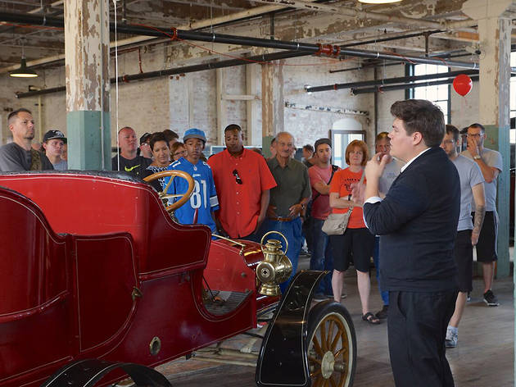
CLG Grant Program
The Basics
Reimbursable grant program
Competitive application process, through which SHPO solicits projects from eligible applicants.
Application round opens in October and closes the following February.
Funds may be used for two categories of projects:
  Planning, Documentation, and Education Projects
  Pre-Development and Development Projects
    Minimum: $2,500 | Maximum: $75,000
    Match requirements vary from year to year (currently $0)

Slide 19
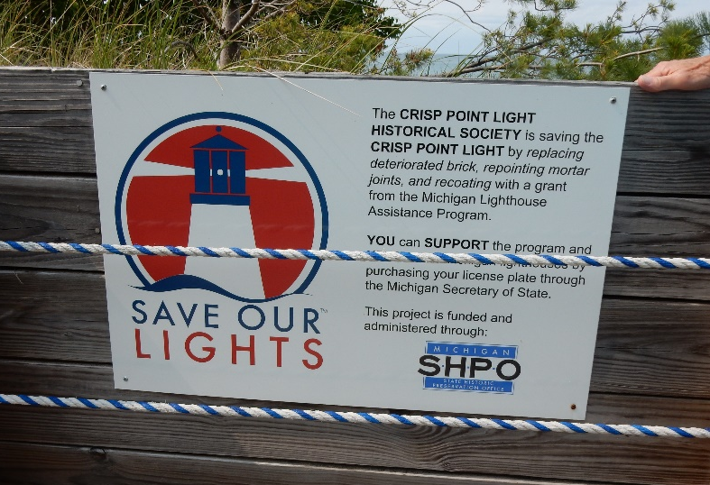

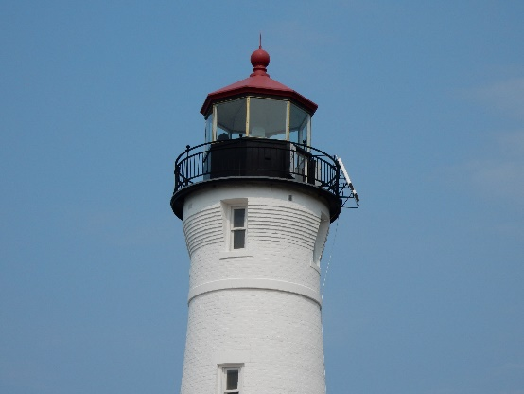
Michigan Lighthouse Assistance Program Grants
Michigan has more lighthouses than any other state!
Program and Eligibility Criteria
Planning and rehabilitation grants - $10,000 to $60,000
Historic preservation easement required
Work must comply with the Secretary of the Interior’s Standards for Rehabilitation
Reimbursement program
Privately owned resources not eligible
Project sign required
Applications due end of November
What Can You Do with the Survey?
www.Michigan.gov/saveourlights

Slide 20

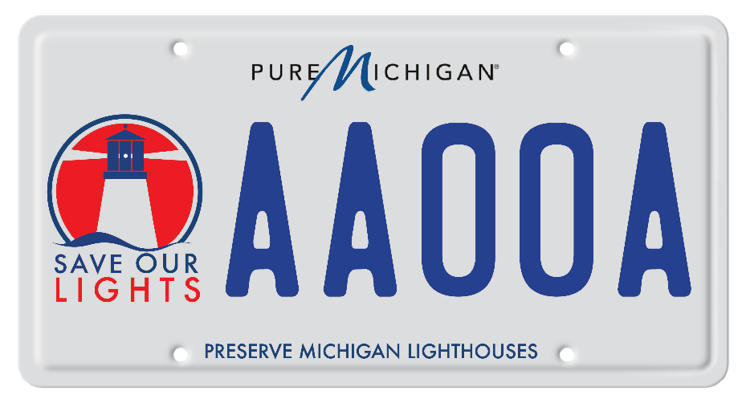
Save Our Lights License Plate
Over $2.7 million in grants awarded since 2000!
Fundraising
$25 from each license plate and $10 from each renewal go into designated fund
Approximately $110,000 raised annually
Total Investment
With required match, over $4 million total invested
Local funding, volunteer hours, etc.
Tourism $
www.Michigan.gov/saveourlights

Slide 21
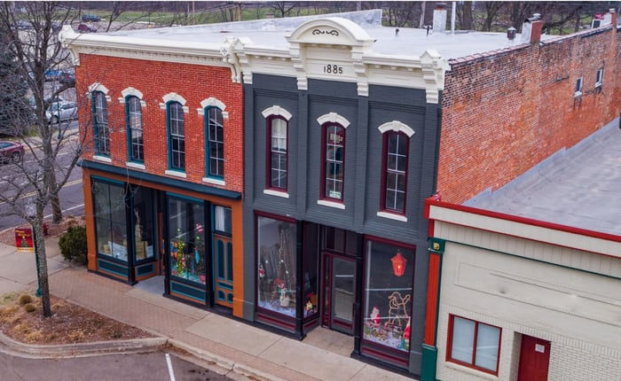
Federal Historic Tax Credit Program
20% Rehabilitation Tax Credit for Historic Properties
Program
Not competitive, capped or allocated
Can be combined with other credits (LIHTC, New Markets)
May be used more than once at the same property
May be used by the same owner more than once
Eligibility Criteria
Qualified rehabilitation expenditures must exceed the adjusted basis or $5,000
All project work must comply with The Secretary of the Interior’s Standards for Rehabilitation
Depreciable end use (owner occupied residences do not qualify
Must be the owner or long-term lessee (residential 27.5 years, non-residential 39 years)
What Can You Do with the Survey?

Slide 22
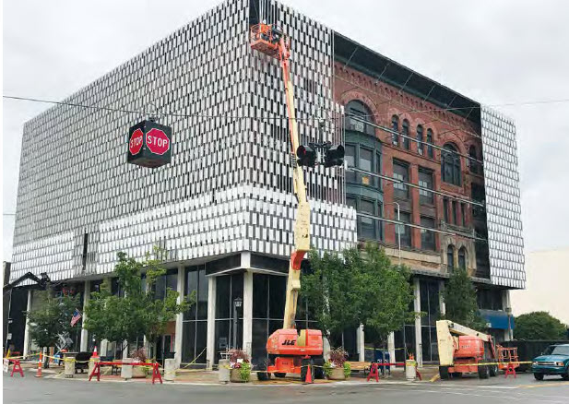
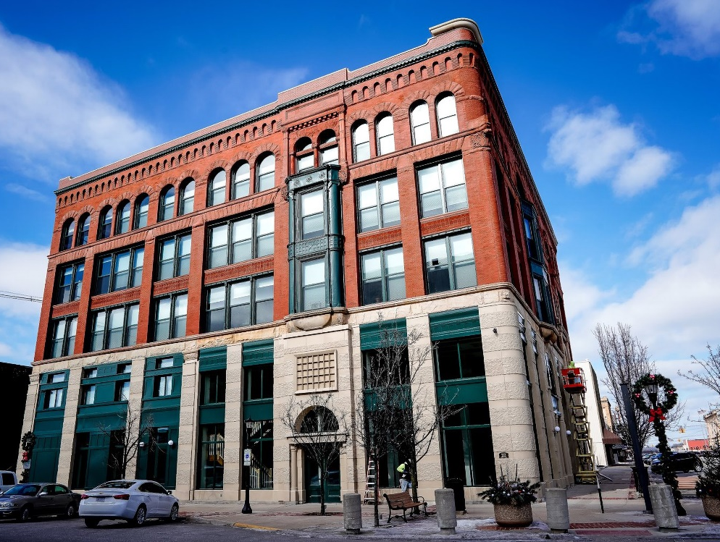
Federal Historic Tax Credit Program
20% Rehabilitation Tax Credit for Historic Properties
Certified Historic Structure
Individually listed in the National Register of Historic Places
Contributes to a district listed in the National Register of Historic Places
Contributes to a National Park Service certified local historic district
Eligible Costs
Capital costs (mechanical, plumbing, roof, bathrooms)
Soft costs (professional fees, developer fees, permit fees)
Ineligible Costs
Acquisition, furnishings, building additions, site work

Slide 23
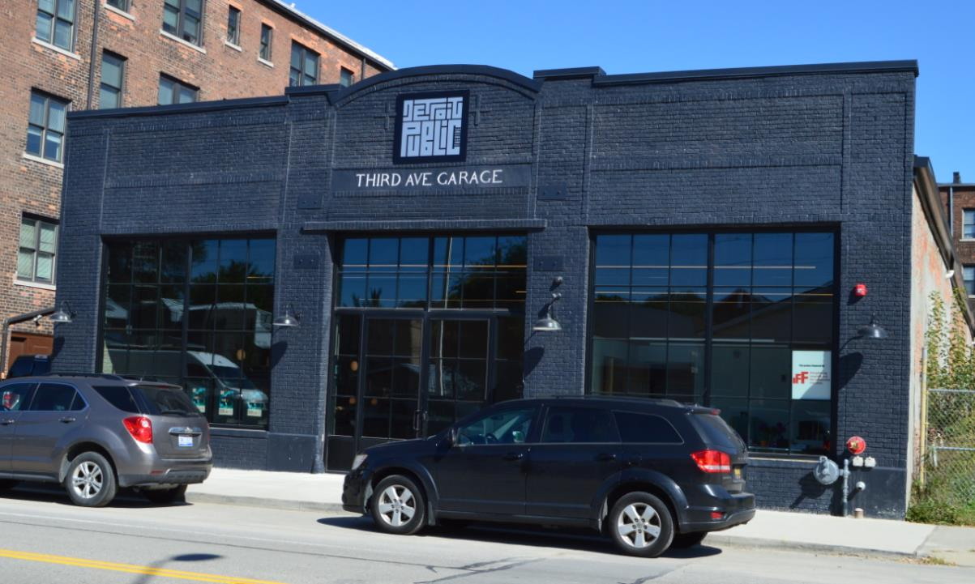
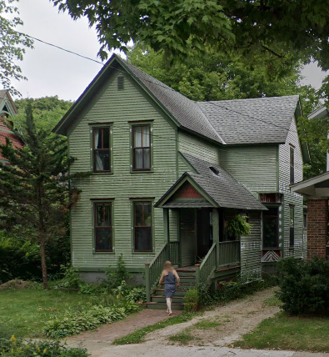
State Historic Tax Credit Program
25% Rehabilitation Tax Credit for Historic Properties
Program
$5M annual cap divided between 3 application categories, allocated on a first-come first-served basis
1 year reach-back for prior completed work
Can be combined with other credits
May be used more than once at the same property
May be used by the same owner more than once
Eligibility Criteria
Qualified rehabilitation expenditures must exceed 10% of the SEV for commercial properties or $1,000 for residential
All project work must comply with The Secretary of the Interior’s Standards for Rehabilitation
Depreciable end use or owner occupied residence
Must be the owner or long-term lessee (residential 27.5 years, non-residential 31.5 years)
What Can You Do with the Survey?

Slide 24
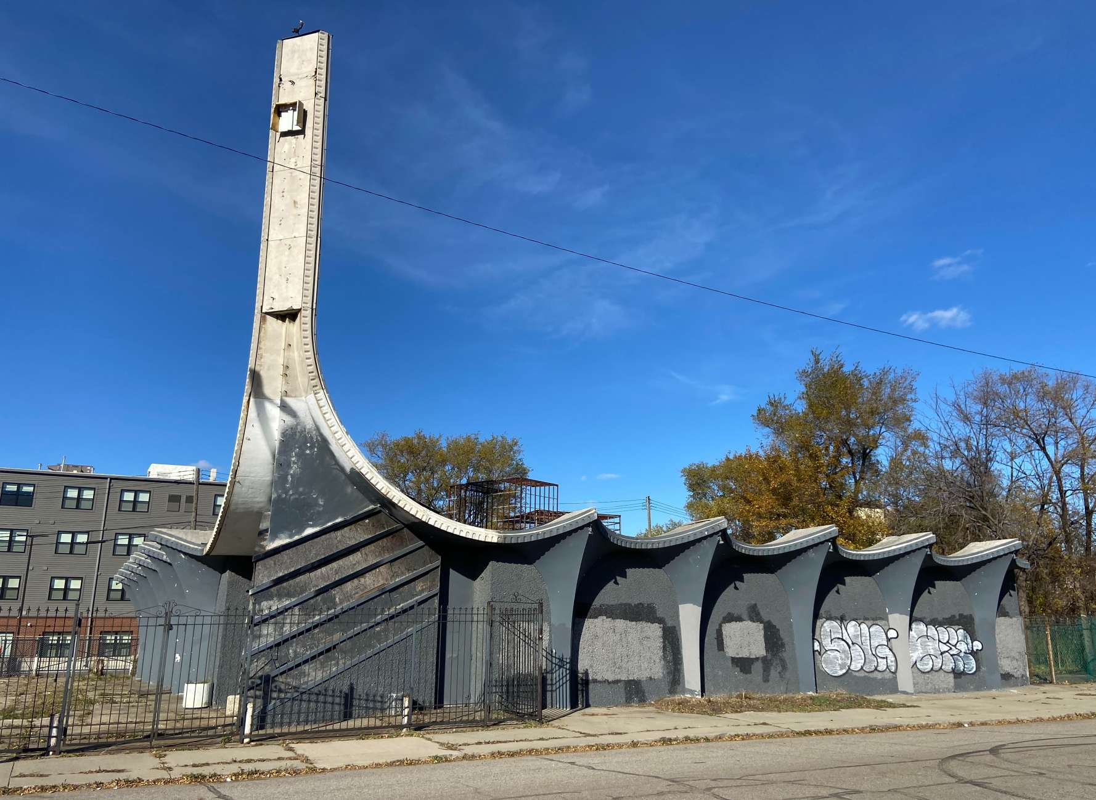
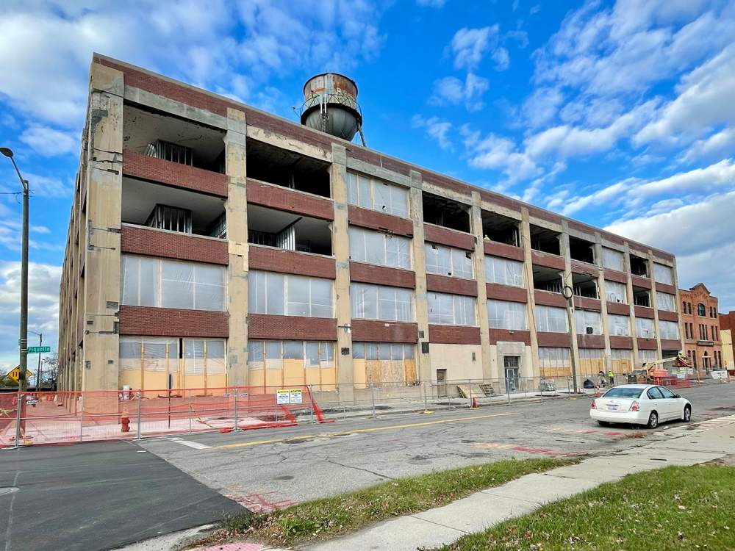
State Historic Tax Credit Program
25% Rehabilitation Tax Credit for Historic Properties
Certified Historic Structure
Individually listed or contributes to a district listed in the National Register of Historic Places
Individually listed or contributes to a district listed in the State Register of Historic Sites
Contributes to a 1970 PA 169, MCL 399.201 to 399.215 Local Historic District.
Eligible Costs
Capital costs (mechanical, plumbing, roof, bathrooms)
Soft costs (professional fees, developer fees, permit fees)
Ineligible Costs
Acquisition, furnishings, building additions, site work

Slide 25
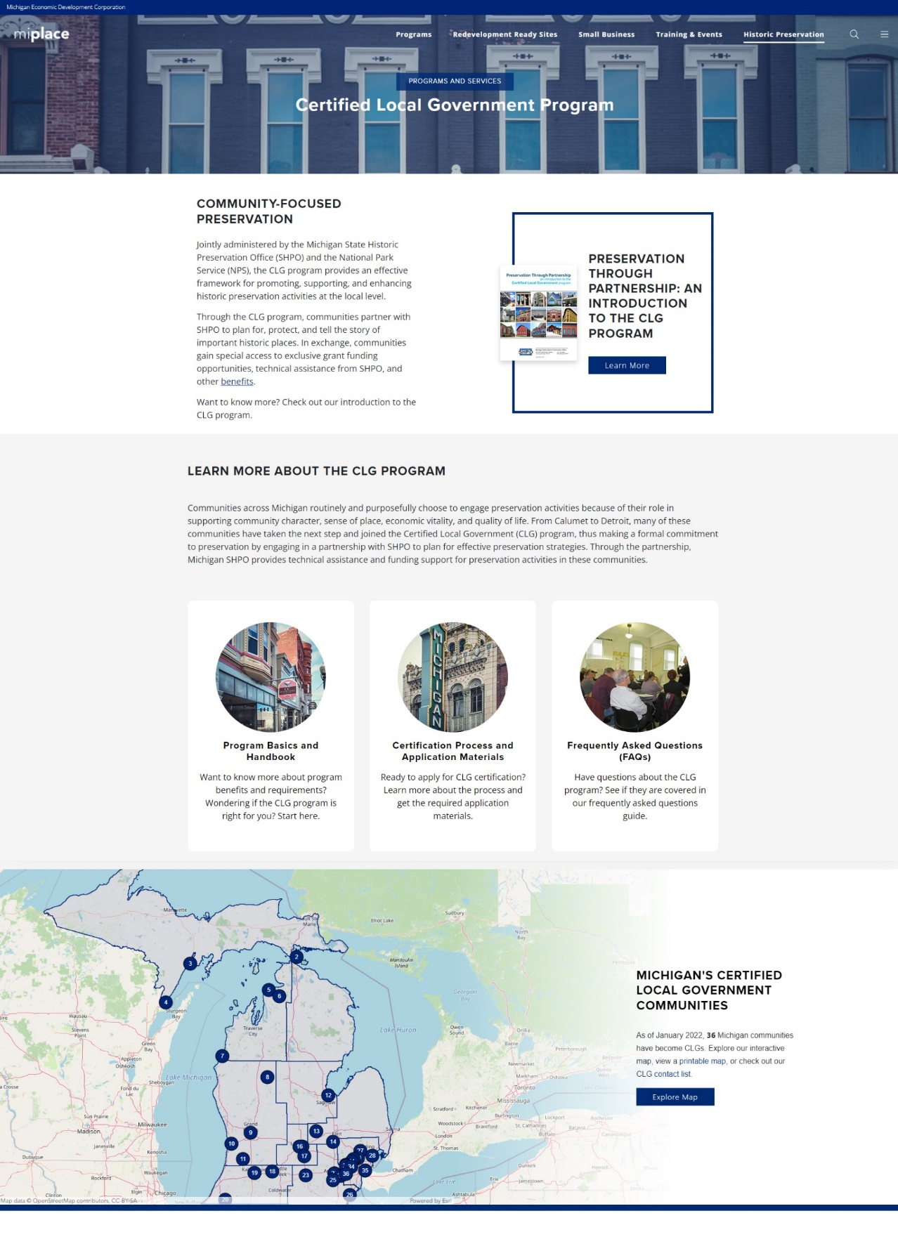
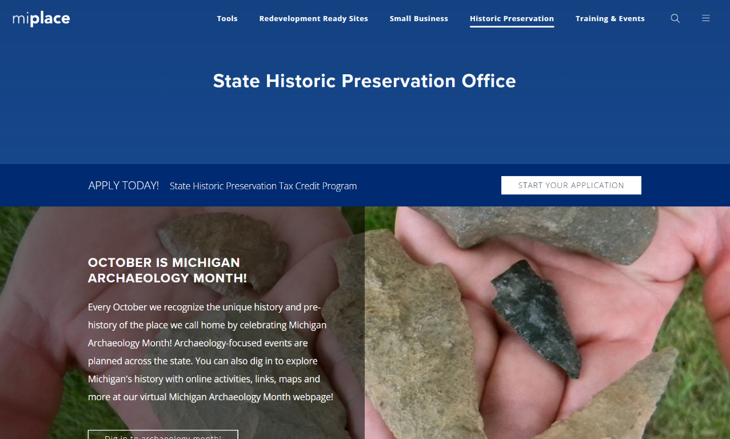
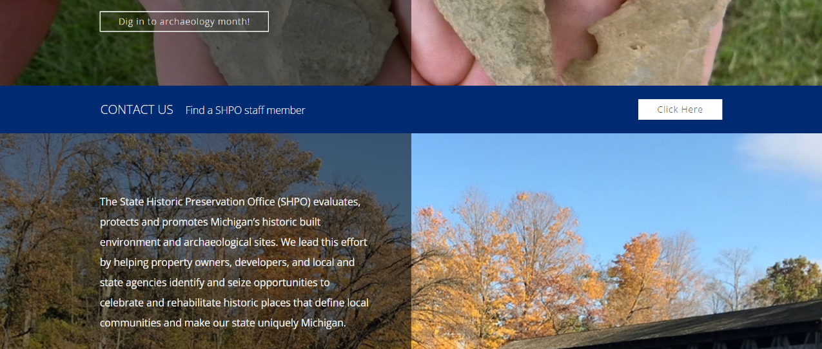
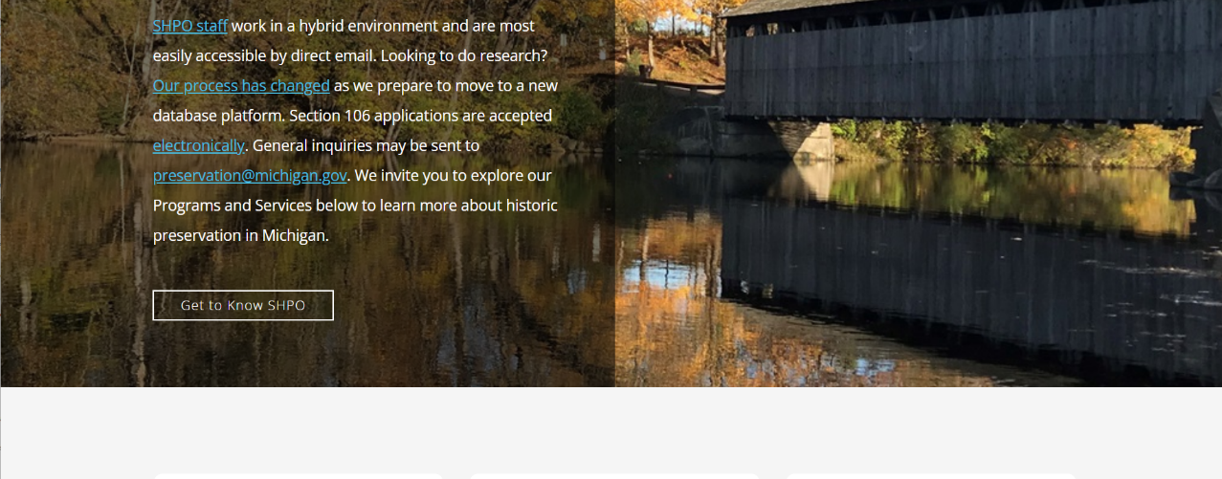
Michigan.gov/SHPO
Questions?
Alan Higgins
Grants Manager
517.256.4358
HigginsS3@michigan.gov
Bryan Lijewski, FAIA, NCARB
Architect Specialist
517.331.4761
LijewskiB@michigan.gov

Slide 26
Q&A

Slide 27
Grant Basics
Determining Alignment and Capacity
Review the application requirements, goals, and guidelines
Assess grant alignment with the strategic plan and with departmental and resident feedback
Leverage existing data to indicate the community’s greatest need

Slide 28
Grant Basics
Determining Alignment and Capacity
Assess staff capacity to complete the application AND implement the proposed project
Identify alignment between the grant and community priorities
Determine if grant requirements can be met and if the timeline is feasible

Slide 29
Upcoming Deadlines
What is coming up …
EPA Community Change Grants
  Application deadline: Thursday, November 21, 2024
Transportation Alternatives Program
  Date for last initial contact with program coordinator: Wednesday, November 27, 2024
Healthy Community Zones Initiative
  Application deadline: Wednesday, November 20, 2024

Slide 30

Closing
What’s Next?
The next webinar is November 21, 2024
Grants are continually being added to the database
The Helpdesk will continue to provide support
New and improved Justice40 resources to come

Slide 31
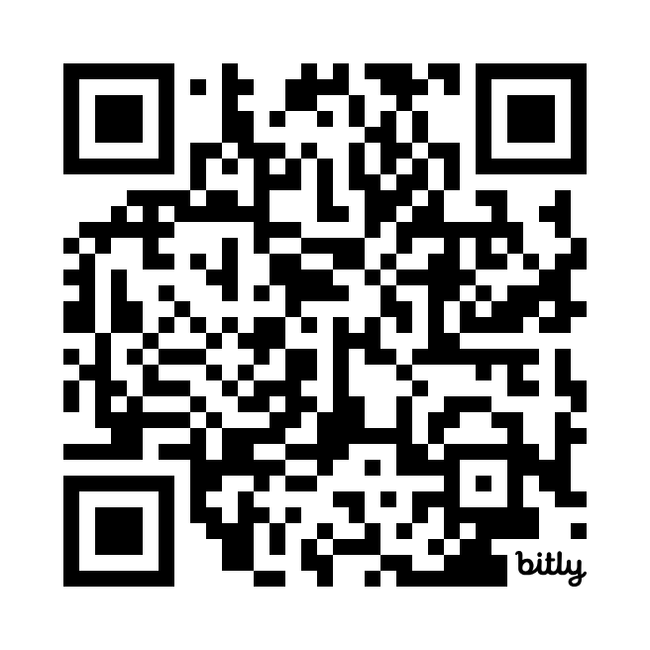
We want to hear from you!
Don’t be shy! Tell us what you think.
Your feedback is vital to the development of MI Funding Hub
Help us build the product to help you

Slide 32
Contact Us
Helpdesk Form
https://mifundinghub.org/get-assistance/ ​
Sign up for monthly newsletters
https://mml.org/programs-services/mifundinghub/signup/

Slide 33
Thank you!

