Slide 1
Welcome!
May 23, 2024

Slide 2
Helping Michigan municipalities navigate new state and federal funding opportunities
Funding support provided by the Michigan Department of Labor and Economic Opportunity; the Michigan Municipal League (MML) team is available now to help communities understand and successfully pursue state and federal recovery and infrastructure funding.

Slide 3
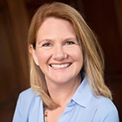
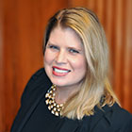
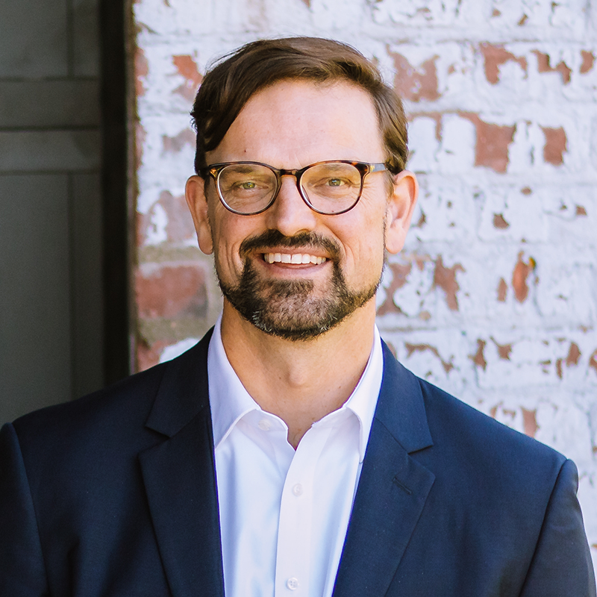
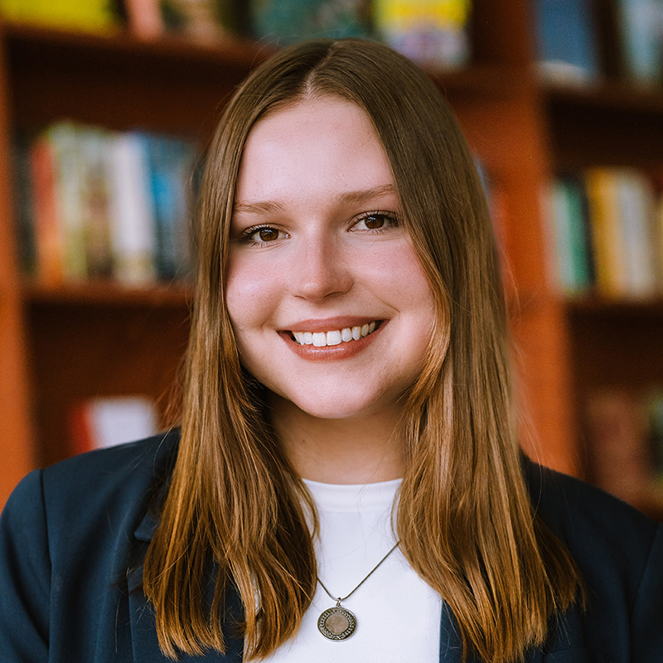
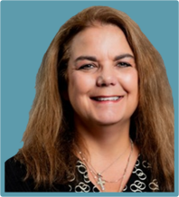
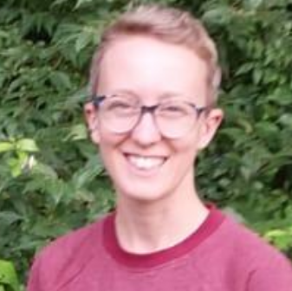
Team Introductions
Michigan Municipal League
Public Sector Consultants
OHM Advisors
  Shanna Draheim, Director of Policy Research Labs
  Melissa Milton-Pung,
  Program Manager
  Joel Howrani Heeres, AICP,
  Director of Community Resilience
  Meagan O’Brien, Consultant
Christine Spitzley, AICP, Principal
  MC Moritz, Project Engineer

Slide 4
Polling Activity
Notes:
What type of community are you representing today?
Rural
Urban
Suburban
Metropolitan
Other
What is your understanding of Justice40 requirements and your community?
We fully qualify as a Justice40 Community
A portion of our population are disadvantaged
Not sure how this is determined.
Help! I have no idea.

Slide 5
Agenda
Program refresher
  MI Funding Hub overview
Technical assistance
  Michigan Infrastructure Office (MIO) Technical Assistance Center
  Q&A
Guest Speakers
  Regina Strong, EGLE Office of the Environmental Justice Public Advocate
  Vince Ranger, OHM Advisors
Justice40 cohort
  Climate and Economic Justice Screening Tool demonstration
Recap and adjourn

Slide 6
MI Funding Hub Review
Community eligibility
Database of federal and State of Michigan grants​
Technical assistance
Capacity building
Articles, toolkits, and other resources​
Ongoing newsletter and webinars
Justice40 communities cohort
Notes:
Who is eligible? Program benefits
Technical and strategic assistance
Grant/funding opportunities and database
Webinars and newsletters
Capacity building
Resource library

Slide 7

Technical Assistance
helpdesk@mifundinghub.org
Send a message to the Helpdesk email address. We will reply with an intake form and follow-up questions.
Fill out the intake form and we’ll coordinate a time to meet virtually.
Talk to our grant experts to discuss funding gaps and opportunities. This meeting is usually 30–45 minutes long.
Receive follow-up support as needed. This support may include the Helpdesk searching for additional funding opportunities or peer reviewing your funding applications.
Notes:
Hand back to Joel

Slide 8
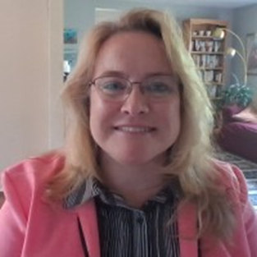
MIO Technical Assistance Center
Kristin Brady
Director
Michigan Infrastructure Office Technical Assistance Center
Notes:
Kris Brady
Director
Michigan Infrastructure Office Technical Assistance Center
Prior to joining the Michigan Infrastructure Office to establish the Technical Assistance Center, Kris Brady served northern Michigan communities for 30 years providing technical assistance including: Needs Assessment, community development master planning, creating community teams to address identified needs, writing strategic plans, identifying funding (federal,state,local),grant writing and administration, program management to completion. Also, through her directorship at Northwest Michigan Community Action, Brady served in leadership positions on statewide boards including the Michigan Homeless Policy Council, Michigan Interagency Council on Homeless, Community Economic Development Association of Michigan and HomeStretch Non-profit Housing Corporation. She is a founding member of the Northwest Michigan Coalition to End Homelessness, Rural Partners of Michigan, and Grand Traverse Area Homeless Youth Initiative. Kris is excited to have established the first MIO Technical Assistance Center and looks forward to utilizing her expertise and passion for service to help grow and build Michigan communities.

Slide 9
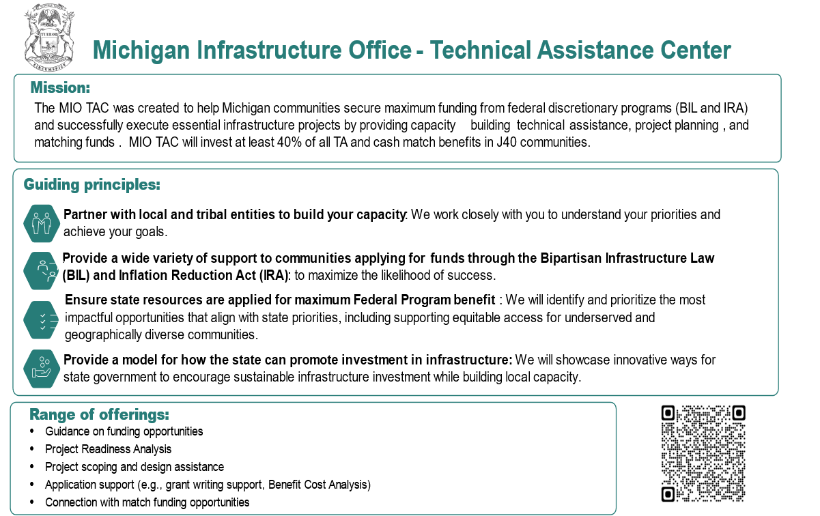
Notes:
Good morning! I’m excited to meet you all and tell you about the new Technical Assistance Center and our resources. Thank you to MML for inviting me to share with you all today. I’m Kris Brady, Director of the new Michigan Infrastructure Office Technical Assistance Center. MIO TAC for short.
READ SLIDE

Slide 10




The MIO TAC team brings a diverse set of skills, expertise, and resources to deliver Technical Assistance for success
Example TAC support areas
  Expertise and tools relevant for helping communities identify, apply for, and capture federal funding opportunities
  Experience building capabilities globally and nationally for states and localities through training sessions, workshops, and technical assistance
  Dedicated economics team that deeply understands U.S DOT BCA process
  Robust BCA and grant writing capabilities
  Strong asset management capabilities
  Extensive State DOT expertise in MI and beyond
  Headquartered in MI with deep roots in the state
  Robust federal and state funding application experience, from opportunity identification to grant writing and submission
Relevant Experience
  Experience serving Michigan across several agencies for the past 5 years
  Completed 2,700+ projects and served 480+ clients related to transportation agencies
  Support supported 20+ states on post-pandemic federal funding
  Supported federal grant funding approach in multiple states; recent projects include:
    Coordinated response for state to identify, socialize, and pursue >$500B in infrastructure funding
    Supported 15 regional grant coalitions to win 13 technical assistance grants ($500K per coalition), and 3 funding grants ($154M total)
  Dedicated knowledge center with expertise across BIL, CHIPS, IRA programs, spanning 11 infrastructure asset classes (e.g., Broadband, Water)
  Supported over 150 federal grant applications across multiple infrastructure programs, including CRISI and RAISE
  Helped applicants win $1.5B+ in funding, including grants for passenger and freight rail, highway, transit, electrification, and complete streets
  Leadership has 100+ years combined deep expertise with MI DOT
  Supported a state DOT on a six-year engagement to assess and improve asset management practices for highway maintenance and other transportation sectors
  Conducted asset management workshops with state DOT and related stakeholders to review and set performance targets
  Active contracts with multiple local governments and stakeholders in Michigan as primary contractor for proposal management and grant application support
  Won over 500 contracts from 275+ different agencies resulting in over $4 billion of funding awarded
1. Benefit Cost Analysis
Notes:
On the TAC team with me are several consultants that are providing the direct technical assistance to the communities. TAC has a master contract with McKinsey and Company. This streamlines commencement of TA as there is no procurement required at the local level. We have done that already.
This slide illustrates the depth and breadth of experience that McKinsey and its subcontracted providers possess.
McKinsey and Company has subcontracted with 3 additional firms to provide all the types of technical assistance we are offering. McKinsey itself, with offices in Detroit, has been working in Michigan for over 5 years, and has coordinated responses for states to identify and pursue over $500billion in infrastructure funding.
Cambridge Systematics, who will provide grant writing and BCA assistance, has supported over 150 federal grant applications across multiple infrastructure programs including RAISE and CRISI, and have won over $1.5Billion for clients.
Rawlins Infra Consult’s leadership has over 100+ years experience with Michigan Department of Transportation and have conducted asset management workshops with MDOT for several years.
JETCO Solutions, also providing grant writing, is headquartered in Michigan. They have won over 500 contracts from 275+ different agencies totaling over $4 billion in funding.
That’s our team, now I’d like to briefly go over the technical assistance offerings in Window 3.

Slide 11

Key Dates
Window 3 – OPEN until 11:59pm on May 31st, 2024
5/15 - Window 3 Opens
5/20 - Webinar
5/24 - Office Hours – Tomorrow!
5/31 - Window 3 Closes
Mid-June – Window Technical Assistance preliminary recipients chosen and notified. TA commences
We expect to open a 4th Window for applications in July 2024
Notes:
This is the general timeline we will strive to follow. We estimate the application submission process should only take approximately 3 hours.
READ SLIDE

Slide 12






Eligible applicants include a range of communities and transit organizations
Local governments (e.g. road commissions) **for transportation grants, local governments should be selected by their MPO or RPA. For non-transportation grants, local govs. Are encouraged to coordinate with their RPA as applicable
Important to note:
  Any eligible applicant must demonstrate support of their local unit of government and demonstrate access rights and approvals of local site ownership. This, with the goal of promoting local coordination with relevant parties
  MPOs and RPAs are responsible for prioritizing and selecting the projects from their member communities to submit to TAC.
School Districts ** school districts must demonstrate support of the municipal gov. responsible for the district (e.g., county, town)
Federally recognized Tribal nations
Technical Assistance Center (TAC)
Rural public transit authorities with support from MDOT
Utility authorities
Urban public transit agencies with support from their affiliated MPO
1. If you are a local government and need help identifying the MPO or RPA to coordinate with, please see the List of MPO/RPAs section in the MIO TAC guidance document.
Notes:
Who can currently apply for technical assistance in this window…
READ SLIDE

Slide 13
Window 3 grants (1/3)
Grant Title | Due Date (estimated) | NOFO expected | Award amts. in the past | Responsible Agency | Eligible Entities | Description
Charging and Fueling Infrastructure (CFI) Discretionary Grant Program | 6/13/2024 | Released | $0.5M - $15M | DOT | States, metropolitan planning organizations, local governments, Tribes, other entities | Provides funding to deploy publicly accessible electric vehicle charging and hydrogen, propane, and natural gas fueling infrastructure on publicly accessible locations
Active Transportation Infrastructure Investment Program (ATIIP) | 6/17/2024 | Released | ~$0.1 - $15M | DOT | Local or regional governmental organizations, multicounty special districts, States, Native American Tribes | Provides funding to identify, prioritize, and implement improvements to the largest barriers to safe, accessible, and equitable pedestrian and bicycle network connectivity
Natural Gas Distribution Infrastructure Safety and Modernization Grant* | 6/20/2024 | Released | ~$5.3M | DOT | City or township governments, utilities, counties, Tribes that own and operate a natural gas distribution system | Supports investments in reducing the risks of leaks in natural gas distribution pipeline systems
Reconnecting Communities Pilot (RCP) Program | 7/2/2024 | Released | ~$12.3M | DOT | Agricultural or silvicultural producer association, state or unit of local government, Tribes, farm cooperatives, other entities | Builds a partner-driven approach to funds solutions to natural resource challenges on agricultural land
Advance partner-driven solutions aka Regional Conservation Partnership Program (RCPP) | 7/2/2024 | Released | $250K-$25M range (per NOFO) | USDA | Ag production org, state, local, Tribal govts, farmer co-ops, higher ed, others | RCPP projects may include a range of on-the-ground conservation activities implemented by farmers, ranchers, and forest landowners such as land management, improvement, and restoration practices; land rentals; easements
Strengthening Mobility and Revolutionizing Transportation (SMART) Grants Program | 7/12/2024 | Released | ~$1.7M | DOT | States, Tribes, public transit agencies or authorities, public toll authorities; MPOs, groups of these organizations | Focuses on the development of advanced technologies for smart cities and communities, and enhancing the efficiency and safety of transportation systems
Communities Taking Charge Accelerator (for those who submitted concept paper) | 7/16/2024 | Released | ~$3M | DOE | Local, regional or Tribal governments, local authorities, utilities, charging network operators, academic institutions, national laboratories, etc. | Funds projects that will expand community e-mobility access and provide clean reliable energy
Notes:
This is the summary of the grants we are supporting in Window 3. A total of 23! It’s a mix of DOT, EPA and USDA discretionary grants. You can see the actual due dates of some of the grants. The estimated dates are our best guess based on last year. For grants that are due in June – I recommend applying for TAC grant writing assistance as quickly as possible. We will be pulling and scoring those as they come in, so we can assign TA fast and get to work!

Slide 14
Window 3 grants (2/3)
Grant Title | Due Date (estimated) | NOFO expected | Award amts. in the past | Responsible Agency | Eligible Entities | Description
Clean Heavy-Duty Vehicles Grants | 7/25/2024 | Released | $0.5M - $60M | EPA | States (including territories), municipalities (includes school districts), Indian Tribes, non-profit school transportation associations | Aims to replace existing non-zero-emission Class 6 & 7 vehicles with zero-emission vehicles
Bridge Investment Program - Large Bridge Project Grants | 8/1/2024 for FY ‘25 funds | Released | $50M, max 50% of total eligible project costs | DOT | State, MPOs, local, Tribes, others | Planning and project grants for bridges with total eligible project costs >$100M (minimum award = $50M)
Brownfields - Job Training (JT) Grants | 8/15/2024 | Released | Up to $500K | EPA | Local + State gov, Non-profits, Redev. Authority, Tribes, others | Provides funding to deliver trainings to unemployed and under-employed residents from communities impacted by brownfields
Pilot Program for Transit-Oriented Development (TOD) Planning | TBD | May 2024 | ~$0.9M | DOT | State and local governments, Tribes, transportation providers and operators | Provides funding to communities to integrate land use and transportation planning for a new fixed guideway or core capacity transit project corridor
Railroad Crossing Elimination Grant Program* | TBD | May 2024 | ~$1.7 - $16M | DOT | States, local government, unit of local government or a group of local governments, Tribes, public port authority, metropolitan planning organization | Provides funding for highway-rail or pathway-rail grade crossing improvement projects that focus on improving the safety and mobility of people and goods
Low Carbon Transportation Materials Program - non-State | TBD | May 2024 | ~$22M | DOT | Cities, Tribes, metropolitan planning organizations, other agencies | Funds projects that will accelerate the use of materials and products that have lower levels of embodied GHG emissions
Restoration and Enhancement Program | TBD | May 2024 | ~$7.3M | DOT | State, groups of States, interstate compacts, public agencies, rail carriers, other agencies | Funds operating assistance grants for initiating, restoring, or enhancing intercity passenger rail transportation
Notes:
Here are more of the grants we are targeting. As you can see, we are targeting grants due over the summer. We are encouraging communities to plan ahead for what grant they want to pursue, so we have as much time to provide the assistance as is possible.
Some of the NOFOs have not been released yet, but we expect all of these soon, at least by mid-summer, as this being an election year, things are coming out earlier than previously anticipated so that the feds can get money obligated.

Slide 15
Window 3 grants (3/3)
Grant Title | Due Date (estimated) | NOFO expected | Award amts. in the past | Responsible Agency | Eligible Entities | Description
Wildlife Crossings Pilot Program | TBD | May 2024 | $200K-$20M | FHA | State, MPOs, locals, RTAs, Tribes, others | Capital grants to reduce wildlife vehicle collisions (e.g., overpass or underpass construction, fencing, etc.) or planning grants (e.g., research on safety)
Reduction of Truck Emissions at Port Facilities | TBD | June 2024 | ~$8M | DOT | Authorities that oversee, operate, or utilize port facilities and/or intermodal port transfer facilities | Provides funding to reduce truck idling and emissions at ports
National Electric Vehicle Infrastructure (NEVI) 10% set aside | TBD | June 2024 | ~$17.6M | DOT | State DOTs, local governments | Supports investments in enhancing and maintaining the EV charging network
Promoting Resilient Operations for Transformative, Efficient, and Cost-saving Transportation Program (PROTECT)* | TBD | July 2024 | ~$1-$40M | DOT | States, MPOs, locals, Tribes, others | Planning grants and construction grants to improve the resiliency of surface transportation resilience to natural hazards
Joint Office of Energy and Transportation Ride and Drive Electric | TBD | August 2024 | N/A ($149M total) | DOE | State, MPOs, local, Tribes, non-profits, for-profits, others | Provides funding to build a national network of EV chargers while supporting EV charging reliability, resiliency, equity, and workforce development
RAISE Local and Regional Project Assistance Grants | TBD | Fall 2024 | $25M max award (no min for planning, $1M-$5M min for capital) | DOT | States, MPOs, locals, Tribes, others | Capital and planning grants for surface transportation infrastructure projects (roads, bridges, rail, ports, transit, EV).
Increasing Land, Capital, and Market Access (Increasing Land Access) Program | TBD | TBD | $6M | USDA | State, MPOs, local, Tribes, non-profits, educational institutions, others | Funds cooperative agreements or grants for projects that help move underserved producers from surviving to thriving
Notes:
This is the final page of grants – you can see some of the variety of federal programs we will support like Wildlife Crossings, reducing truck emissions specifically at Ports, maintaining EV charging equipment and more.
When we open Window 4, we may repeat the opportunity to apply for help in applying for some of these grants. It will depend on the timing of the release of the Federal NOFO. Start planning early!

Slide 16

How MIO TAC differs from
MI Funding Hub
MIO TAC focuses on Federal Discretionary Programs created under the Bipartisan Infrastructure Law, the Inflation Reduction Act and the CHIPS and Science Act.
MIO TAC provides grant writing, preparation of technical documents, and grant process management for awarded communities for those grants.
MIO TAC may be able to reserve a portion of the local match for applications being made to those grants.
Grant Identification is one on one workshops that are project specific. Grant Fact Packs library.
Notes:
In order to help you figure out where to start, here is a summary of how TAC differs from MI Funding Hub. MIO has collaborated with MML, and we have developed complimentary offerings. We refer communities back and forth often! Both programs have valuable services to provide you with appropriate and effective assistance. At MIO TAC we focus on… READ SLIDE

Slide 17

OR
Scan this QR code to visit the
MIO Technical Assistance Center Website
Please Contact:
Kris Brady, Director
MIO Technical Assistance Center
BradyK4@michigan.gov
Notes:
Thank you again for allowing me your time! I hope to see some of you at office hours tomorrow!

Slide 18
Questions About MIO?

Slide 19
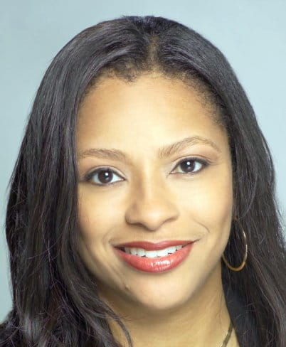
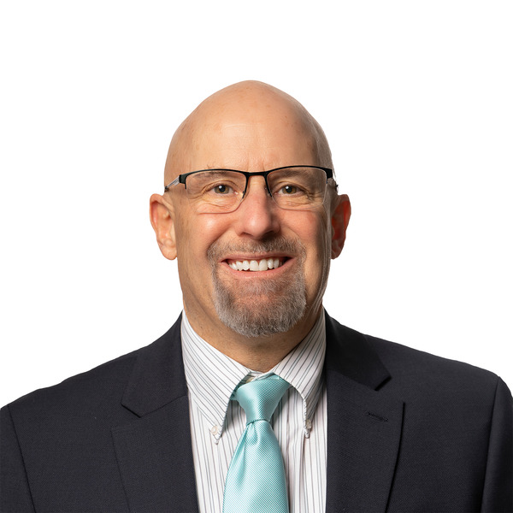
Guest Speakers
Regina Strong
Environmental Justice Public Advocate
Department of the Environment, Great Lakes, and Energy
Vince Ranger
Senior Technical Specialist
OHM Advisors
Notes:
Regina Strong
Regina Strong leads the Office of the Environmental Justice Public Advocate (OEJPA) in Michigan's Department of Environment, Great Lakes, and Energy (EGLE).
Gov. Gretchen Whitmer created the office in 2019 as an external and internal voice for Environmental Justice throughout Michigan. leads the state’s Interagency Environmental Justice Response Team and established the Michigan Advisory Council on Environmental Justice. For more than 30 years, Regina has been a leader in public affairs, advocacy, and the fight for justice and equity. Achieving Environmental Justice and intentionally addressing systemic inequities are core elements of her work. Clean Coal @ Sierra Club
Vince Ranger
Vince Ranger is a Senior Technical Specialist with OHM Advisors serving in the Municipal Group. Mr. Ranger brings almost 30 years of experience working with the Michigan Department of Transportation to his role at OHM Advisors. In his last role at MDOT, Mr. Ranger assisted communities with the planning and development of community-building projects, as well as to help identify potential funding sources for the projects. At OHM, Vince relies on his experience working with communities and his knowledge of federal and state grant programs to assist other OHM staff in developing potential grant-funded projects.

Slide 20

Environmental Justice Impact Grants
Regina R. Strong, MS APR
Office of the Environmental Justice Public Advocate
May 23, 2024

Slide 21
Office of the Environmental Justice
Public Advocate
Created by Governor Whitmer via Executive Order 2019-06
EO also created the Interagency Environmental Justice Public Advocate
Michigan Advisory Council on Environmental Justice (MACEJ) began meeting in February 2020
OEJPA team works with communities with environmental justice concerns and tribal communities across the state

Slide 22
About EJ Impact Grants
State’s First Environmental Justice Grant
$20 million approved by the Michigan Legislature & Governor Whitmer
Grant Program designed and managed by the Office of the Environmental Justice Public Advocate

Slide 23
Purpose of EJ Impact Grants
Reduce environmental health burdens and impacts in Michigan’s environmental justice communities.
Positively impact residents in environmental justice communities by funding place-based and equity-focused projects.

Slide 24
Project Categories
Indoor air quality in schools & daycare centers
Pollution monitoring (non-regulatory)
Contamination/blight remediation & redevelopment
Community projects to improve public health

Slide 25
Eligible Applicants
Federally recognized Tribes
Community-based non-profit organizations (including grassroots and frontline organizations)
Schools
Institutions of higher education
Local governments

Slide 26
Application & Award Selection Timeline
May, June, July | Application open Webinars/training to support applicants
July 15 | Applications Due
September 2024 | Award selection
September 2027 | Project completion deadline

Slide 27
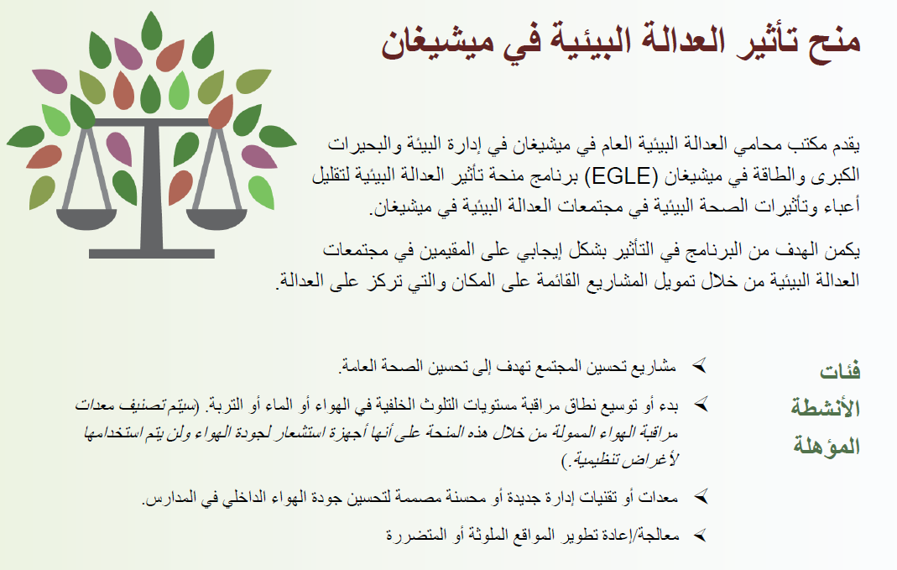
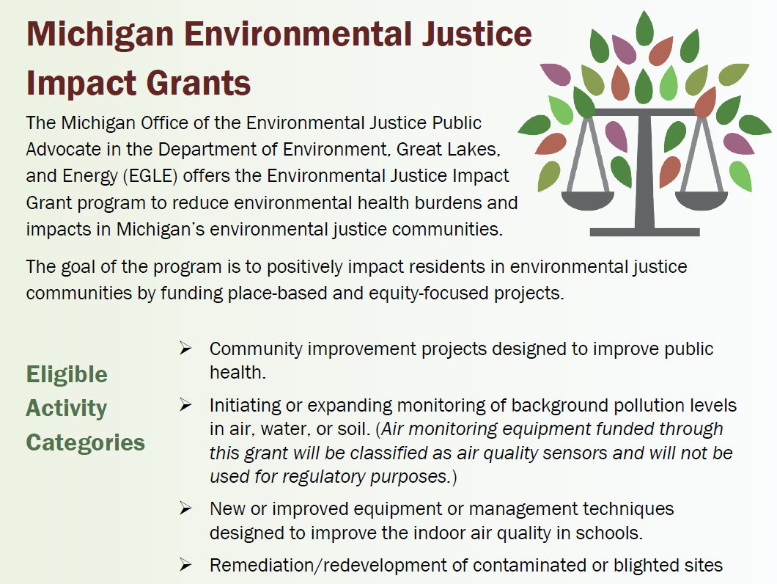
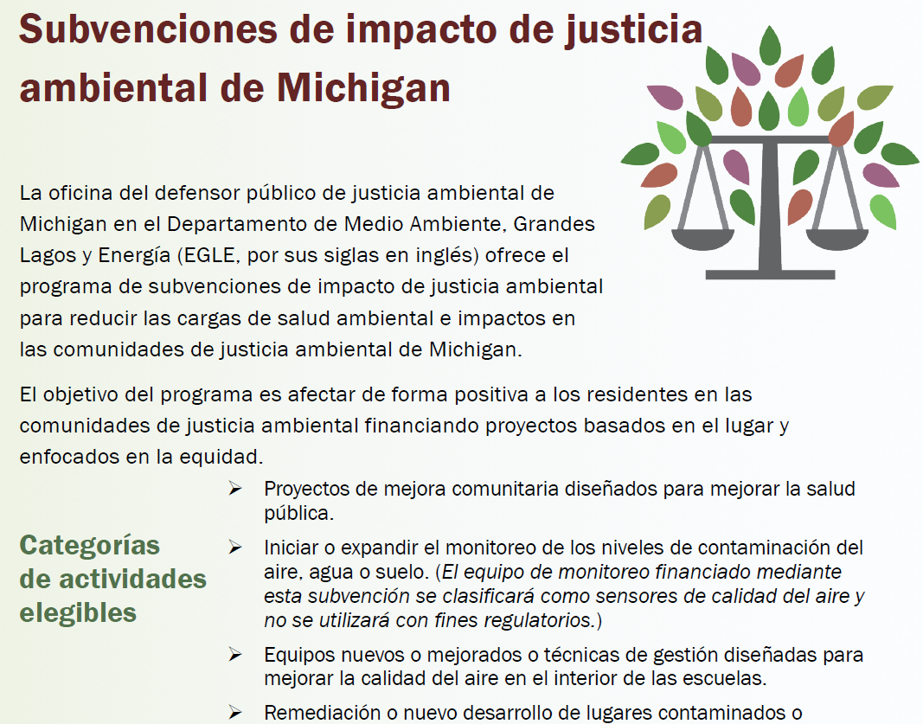
EJ Impact Grant Resources
2-page program overview
  English
  Arabic
  Spanish

Slide 28

EJ Impact Grant Resources
Program Guide
  currently English only
  Spanish & Arabic coming soon

Slide 29
Application Pieces
Application Form
Project Workplan
Project Cost Detail

Slide 30
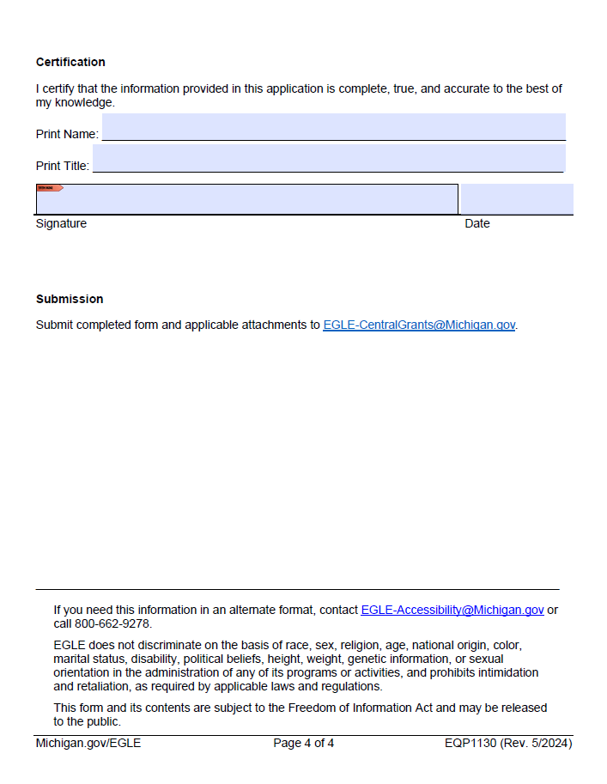
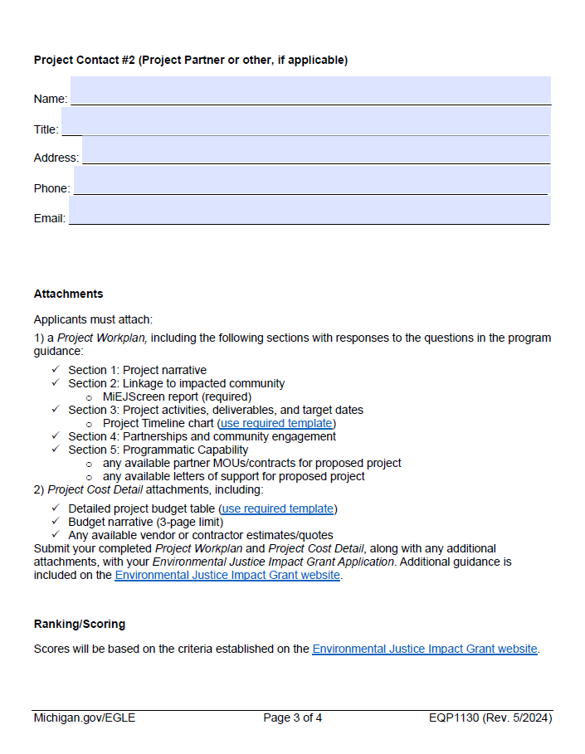
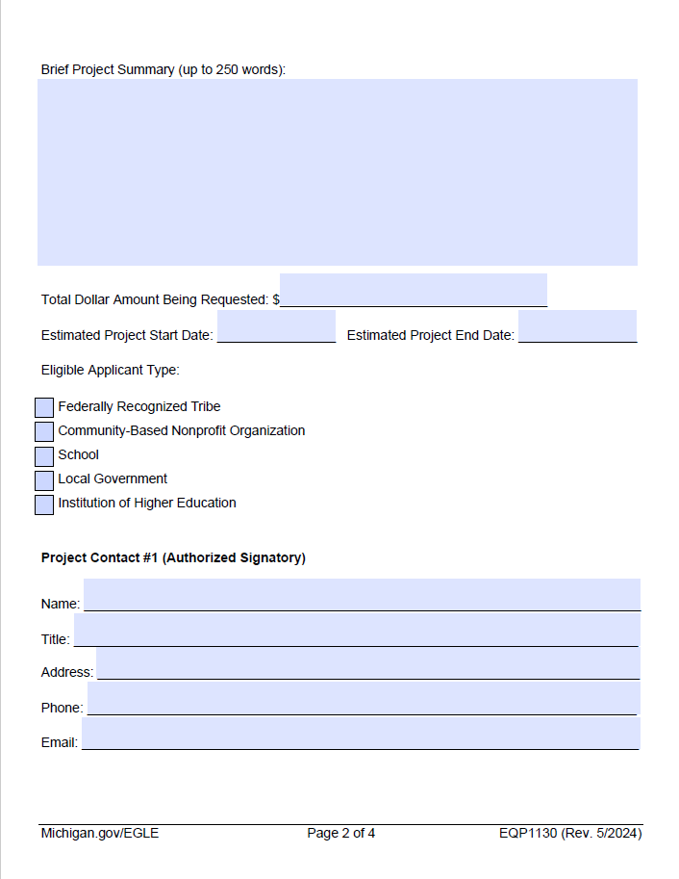
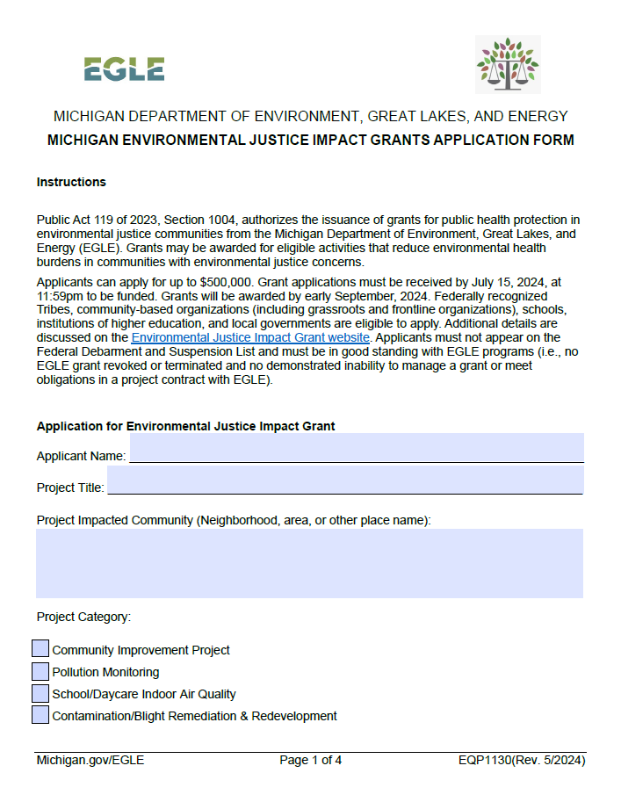
Application Form

Slide 31
Project Workplan Sections
Project Narrative
Linkage to impacted community (required MiEJScreen report)
Project activities, deliverables, target dates (required timeline template)
Partnerships and community engagement
Programmatic capability

Slide 32
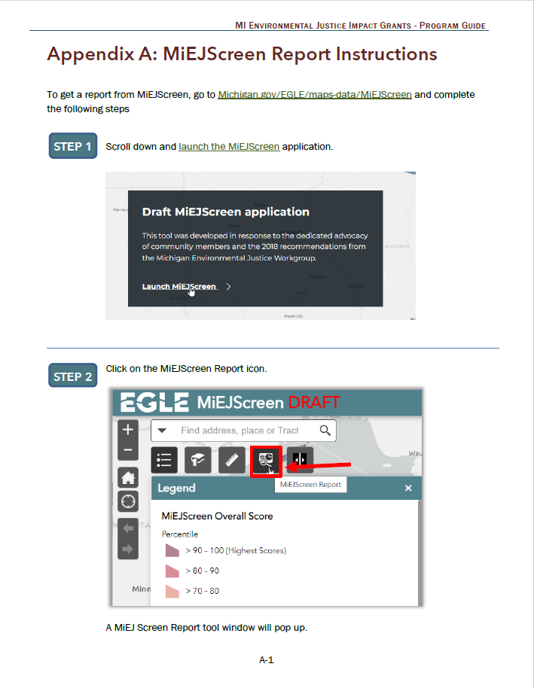
MiEJScreen Report

Slide 33
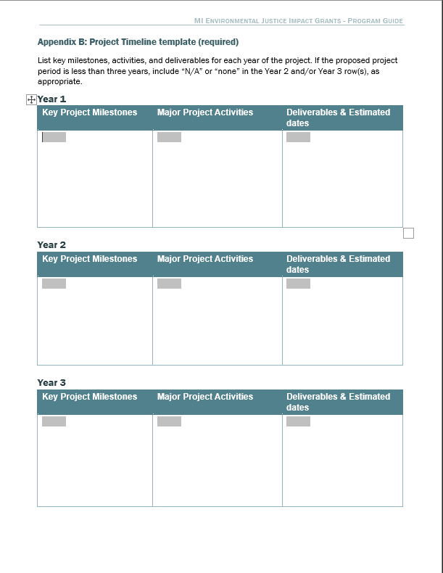
Project Timeline template

Slide 34
Project Cost Detail Sections
Detailed budget table
Budget narrative
Additional available documents (vendor estimates, etc.)

Slide 35
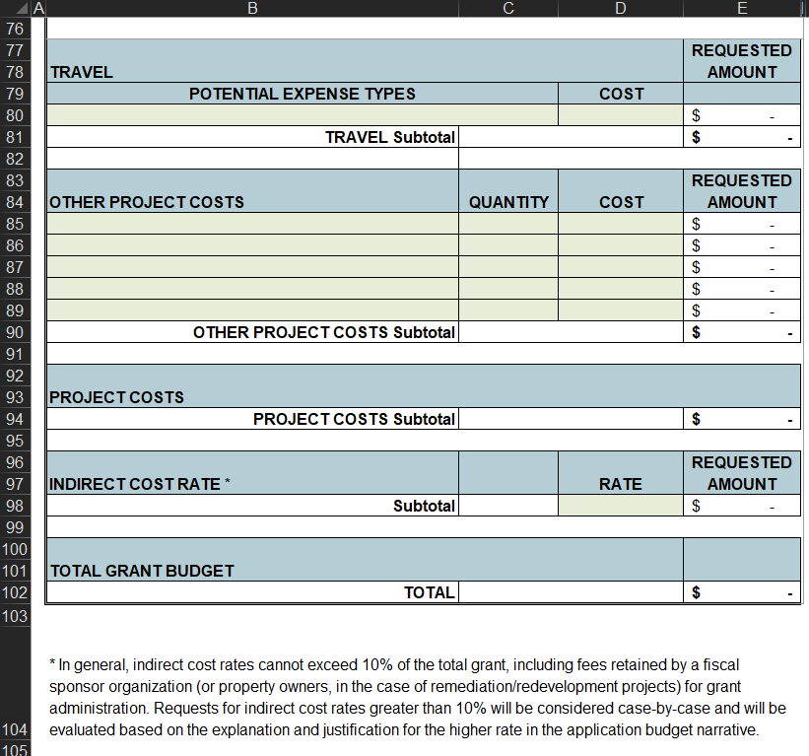
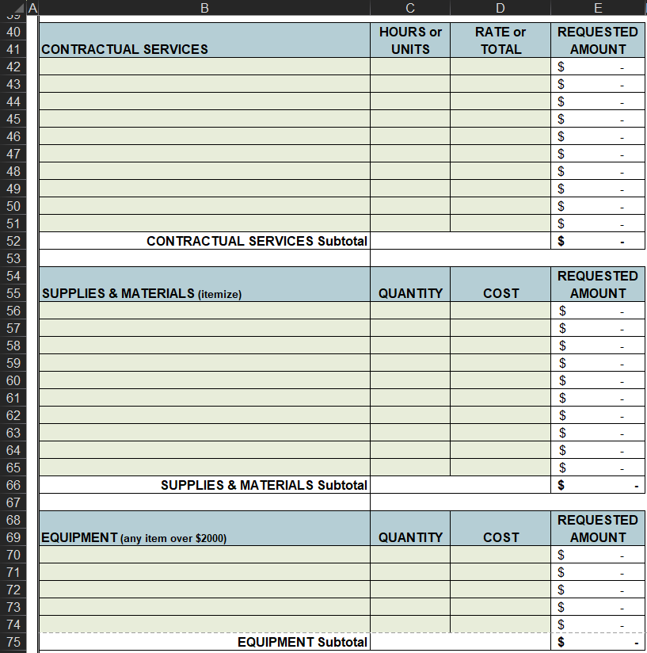
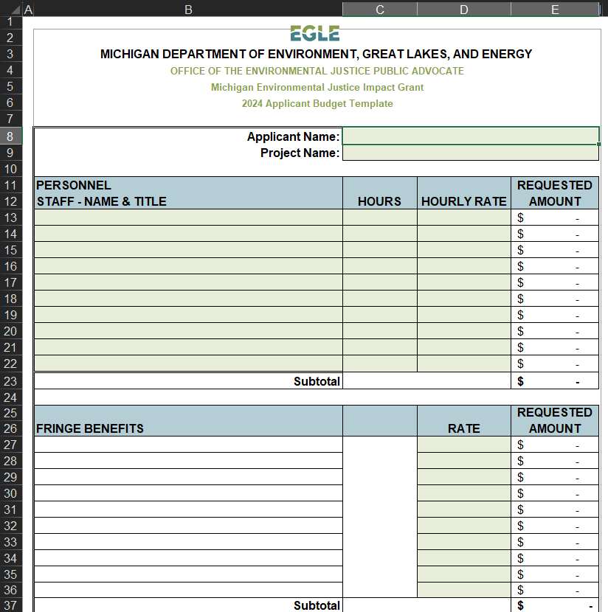
Detailed Budget Table template

Slide 36
EJ Impact Grants Summary
$500,000 per applicant
Tribes, non-profits, schools, institutions of higher education, and local governments can apply
Project categories:
  Community improvement projects to improve public health
  Non-regulatory pollution monitoring
  School indoor air quality
  Contaminated/blighted site remediation or redevelopment
Applications due July 15, 2024

Slide 37
Michigan Environmental Justice Impact Grants
See EJ Impact Grant website for complete and updated information!
Contact info:
www.Michigan.gov/environmentaljustice
EGLE-EnvironmentalJustice@michigan.gov
HutchensK1@Michigan.gov

Slide 38
Community Change Grants (CCG)
$2 billion available through US EPA Environmental and Climate Justice Community Change Grants program
Community-driven investments (awards of $10-20 million)
Facilitating engagement of disadvantaged communities in public processes (awards of $1-3 million)
Applicants must be a partnership between a community-based org and at least one other eligible entity (Tribe, local government, institution of higher education, or another CBO)
Request match funding for apps submitted by July 1 through Make it in Michigan Competitiveness Fund’s Climate Justice Challenge
Submit the CCG Support/Interest Form to connect with State of Michigan TA referrals and potential partners

Slide 39





Vince Ranger
Senior Technical Specialist
OHM Advisors
Vince Ranger
Senior Technical Specialist OHM Advisors
https://www.michigan.gov/mdot/programs/grant-programs

Slide 40
The Transportation
Alternatives Program (TAP)
Supports intermodal transportation systems
Funds place-based economic development by offering transportation choices, promoting walkability, and improving quality of life.
Uses federal transportation funds designated by Congress
Eligible applicants
County Road Commissions
Cities and Villages
Tribal Governments.
Regional Transportation Authorities
Transit Agencies
State and Federal natural resource or public land agencies
Nonprofits responsible for the administration of local transportation safety programs
MDOT may partner with a local agency to apply for funding and implement the project. Other organizations, such as townships or trail groups, may partner with an eligible agency to apply.

Slide 41
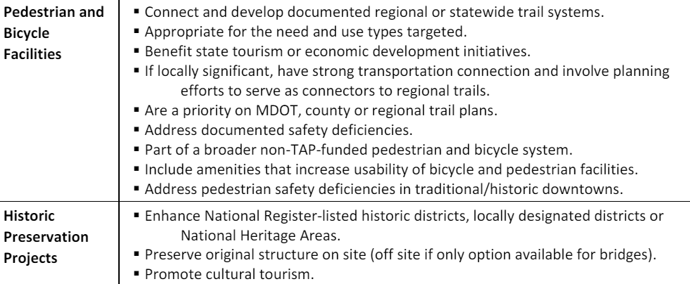
Match Requirement
20%, but a project with additional match commitment is considered more competitive
Example TAP Project Types

Slide 42
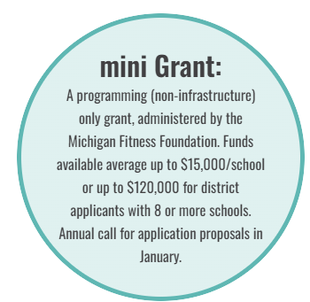
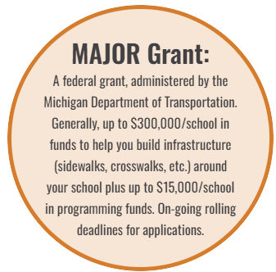
Eligible applicants
All schools with at least one grade in the K-12 range. All schools, whether public, charter, tribal, or private, may apply.
Applicants may be school administrators, teachers, parents, students, law enforcement, local and state representatives, school transportation directors, local/regional planners, bike groups, parks and recreation specialists, neighborhood associations, services and groups.

Slide 43
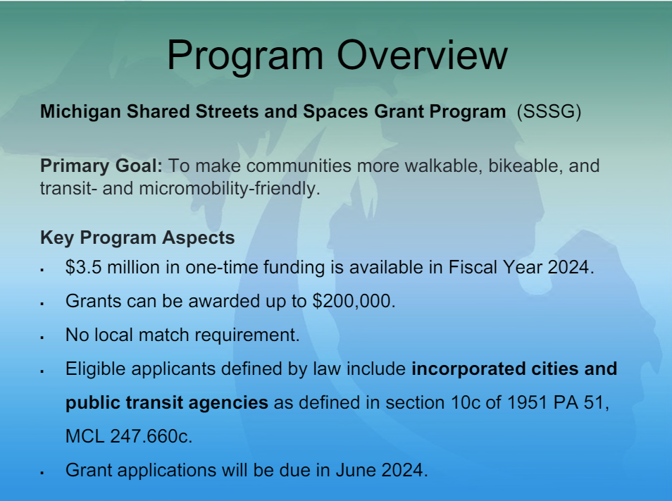
Slides copied directly from the April 2024 webinar, available online
https://www.michigan.gov/mdot/programs/grant-programs/sssg
June 7, 2024

Slide 44
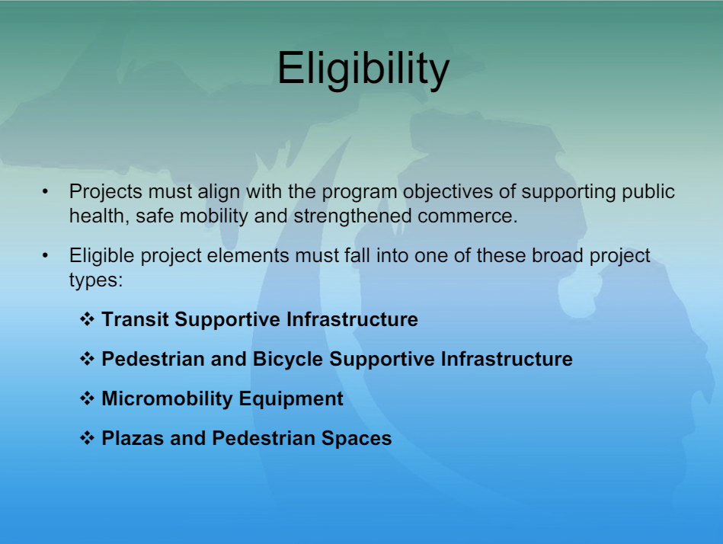
Slides copied directly from the April 2024 webinar, available online
https://www.michigan.gov/mdot/programs/grant-programs/sssg

Slide 45
Eligible Applicants
CATEGORY A
ECONOMIC DEVELOPMENT
ROAD PROJECTS
Eligible recipients include MDOT, all county road commissions, and all city and village street agencies
CATEGORY B
VILLAGES AND
SMALL CITIES
Villages and small cities with a population of 10,000 or less
CATEGORY F
URBAN AREAS IN
RURAL COUNTIES
Eligible recipients are county, city, and village road agencies within counties with a population of 400,000 or less.

Slide 46
Goal
To promote increased economic potential and improve the quality of life through the support of job creation and retention in Michigan.
Eligible Projects…
1. Will create or retain permanent jobs
2. Are immediate and non-speculative
2. Increase the tax base of the local area
(if the project applicant is a local unit of government)
4. Relate to one or more of the following target industries:
CATEGORY A
ECONOMIC DEVELOPMENT
ROAD PROJECTS
Agriculture or food processing
Office centers (at least 50,000 sq ft)
Medical research or medical tourism facilities (at least 50,000 sq ft)
High technology research
Manufacturing
Mining
Tourism
Forestry

Slide 47
Required Match
Minimum of 20 percent match
Evaluation credit will be given to projects whose match exceeds the minimum required
Project planning, design, and right-of-way acquisition costs are eligible for use as match
CATEGORY A
ECONOMIC DEVELOPMENT
ROAD PROJECTS

Slide 48
Goal
The Community Service Infrastructure Fund (CSIF), commonly referred to as TEDF Category B was designed as a stop gap measure to provide additional road funding to the smallest communities in Michigan, particularly those with limited ability to fund road projects.
Eligible Projects…
Direct costs associated with:
Reconstruction
Replacement
Rehabilitation
Preventative Maintenance
of city/village streets AND
stormwater improvements needed
for the road project
Funds cannot cover:
Design Engineering
Construction Engineering
Right-of-way acquisition
Water / Sanitary
Sidewalk
CATEGORY B
VILLAGES AND
SMALL CITIES

Slide 49
Required Match
The maximum grant amount is the lesser of 50% of the eligible and participating costs, up to $250,000.
The remainder of the project costs will be provided by the local agency.
To receive the entire $250,000, the eligible and participating work would have to equal or exceed $500,000
CATEGORY B
VILLAGES AND
SMALL CITIES

Slide 50
Goal
To provide system continuity with the secondary all-season road system.
Eligible Projects…
Must be for improvements to all-season federal aid-eligible roads (or to bring federal aid eligible roads up to all-season standards)
Must be located within the Federal Adjusted Census Urban Boundary of an urban area with a population of 5,000 or greater.
CATEGORY F
URBAN AREAS IN
RURAL COUNTIES

Slide 51
Required Match
Minimum of 20% match
CATEGORY F
URBAN AREAS IN
RURAL COUNTIES

Slide 52
What Is Justice40?
Requirement that 40 percent of the benefits of federal programs flow to disadvantaged communities.
Low-income communities and communities of color experience the greatest environmental and climate impacts, ranging from more polluted air to higher safety risks during extreme storms.
Notes:
https://www.nrdc.org/stories/what-justice40-initiative

Slide 53
What Is a Justice40 Community?
Justice40 communities are defined as low-income census tracts (where > 65 percent of households are at or below two times the federal poverty level) that also experience at least one other environmental, economic, or health burden, such as a high level of particulate matter in the air or an increased flood risk.
All federally recognized tribes also fall under this umbrella.
Nearly 29 percent of the U.S. population qualifies
Notes:
https://www.nrdc.org/stories/what-justice40-initiative

Slide 54
What Funding Streams Does Justice40 Apply To?
Climate change
Clean energy and energy efficiency
Clean transit
Affordable and sustainable housing
Remediation and reduction of legacy pollution
Critical clean water and wastewater infrastructure
Training and workforce development related to these investment areas

Slide 55
CJEST Tool
Helps to answer:
Where are disadvantaged communities within my municipality?
What is the nature of the disadvantages?
What types of grants does this qualify me for?

Slide 56
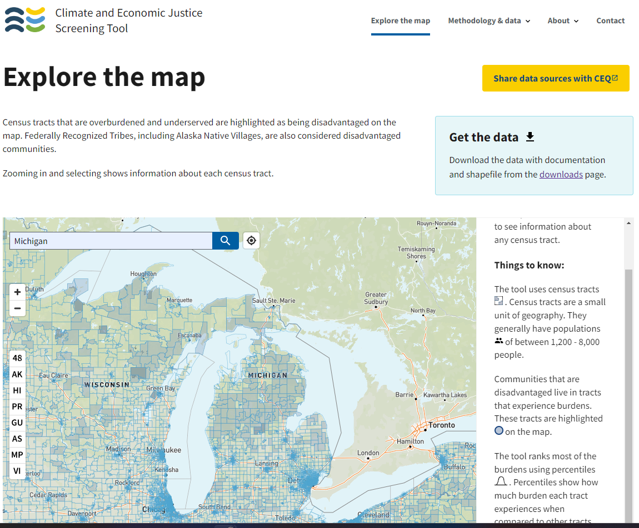
Climate and Economic Justice Screening Tool
Where are disadvantaged communities within my municipality?
What is the nature of the disadvantages?
What types of grants does this qualify me for?
Notes:
https://screeningtool.geoplatform.gov/en/#3/33.47/-97.5

Slide 57
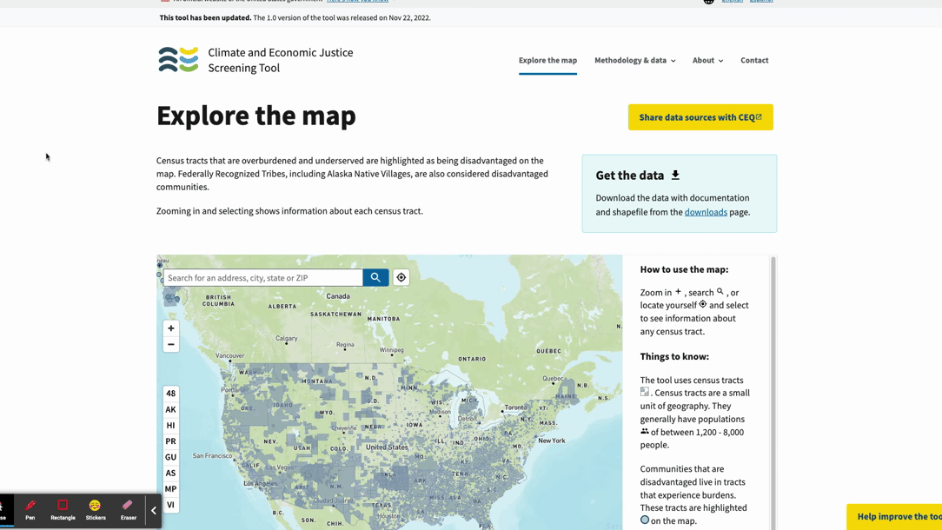
Notes:
https://screeningtool.geoplatform.gov/en/#3/33.47/-97.5

Slide 58
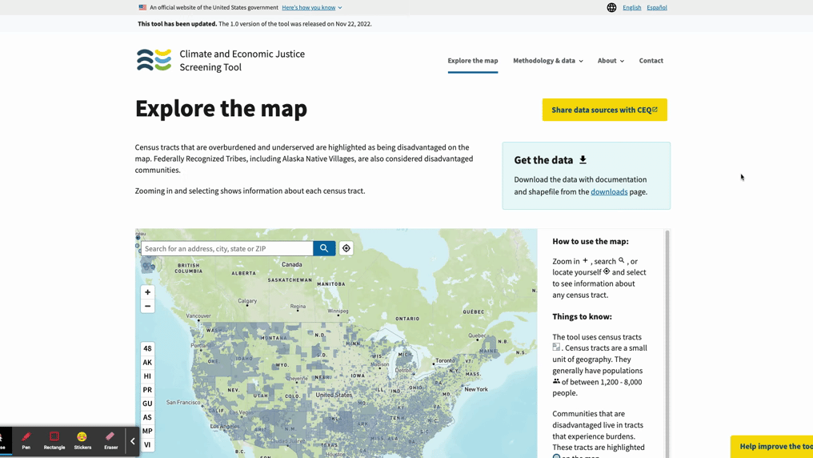
Notes:
https://screeningtool.geoplatform.gov/en/#3/33.47/-97.5

Slide 59
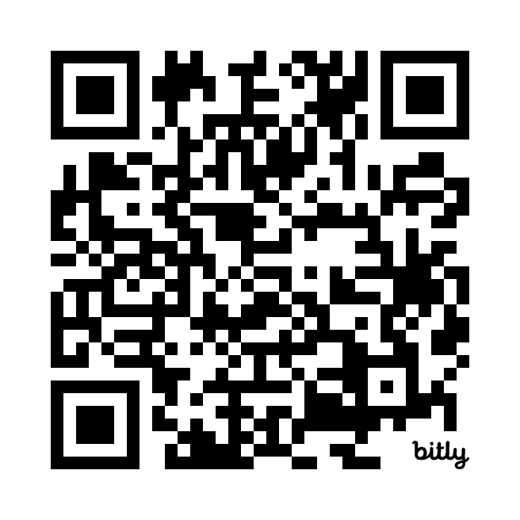
Justice40 Communities
Capacity-building cohort
Program overview
Who is eligible?
Benefits of participating
Cohort One launches May 30, 2024
Sign up to be invited to the next cohort
Notes:
Drop link in the chat

Slide 60
Justice40 Webinar Series
Session breakdown
Session One
  Introduction to Justice40
  Community eligibility
Session Two
  Grant writing for success
  Community partnerships
Session Three
  Roundtable: Grant writing technical assistance
Session dates for Cohort Two: To be announced

Slide 61
Questions?

Slide 62
Upcoming Grant Opportunities
Don’t forget about these…
Source Water Protection Grants
MI Neighborhood Program
Coastal Habitat Restoration and Ecosystem Land Conservation Funding Opportunity
Notes:
Source Water Protection Grants
To provide matching funds to public water supply systems for the development and implementation of a source water protection program to help prevent drinking water sources from becoming contaminated. These funds can be used to develop a Surface Water Intake Protection Program for systems utilizing surface water or to develop a Wellhead Protection Program for those systems that use groundwater sources.
Up to $500,000 made available
Applications due June 15th
MI Neighborhood
In FY24, MI Neighborhood will provide up to $60 million to fund projects statewide across all activities. Regional investment targets have been developed using an equitable, transparent, data driven strategy. Regions are based on the 15 regional housing partnerships identified in the Statewide Housing Plan.
Awards up to $2.0 million
Three application rounds left in FY2024 with the final round ending on July 1st.
Coastal Habitat Restoration and Ecosystem Land Conservation
The Michigan Department of Environment, Great Lakes, and Energy (EGLE), Water Resources Division (WRD), Michigan Coastal Management Program (MCMP) is seeking letters of intent (LOI) for projects to submit to the federal funding competition made available through the Bipartisan Infrastructure Law, Public Law. The funding competition is being administered by NOAA for Coastal Habitat Restoration and Land Conservation projects. This funding is intended to support projects that protect or restore ecologically significant habitats that play a critical role in helping communities become more resilient to coastal hazards and the impacts of climate change.
Awards up to $6.0 million
LOIs due June 7th, 2024

Slide 63

Closing
Recap Webinar
What’s next?
  June webinar and newsletter
  Justice40 Cohort One May 30, 2024
  More grants

Slide 64
Contact Us
Helpdesk email
helpdesk@mifundinghub.org ​
Sign up for monthly newsletters
https://mml.org/programs-services/mifundinghub/signup/

Slide 65
Thank you!

