Slide 1
Welcome!
June 20, 2024

Slide 2
Helping Michigan municipalities navigate new state and federal funding opportunities
Funding support provided by the Michigan Department of Labor and Economic Opportunity; the Michigan Municipal League (MML) team is available now to help communities understand and successfully pursue state and federal recovery and infrastructure funding.

Slide 3
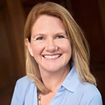
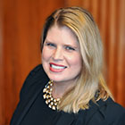
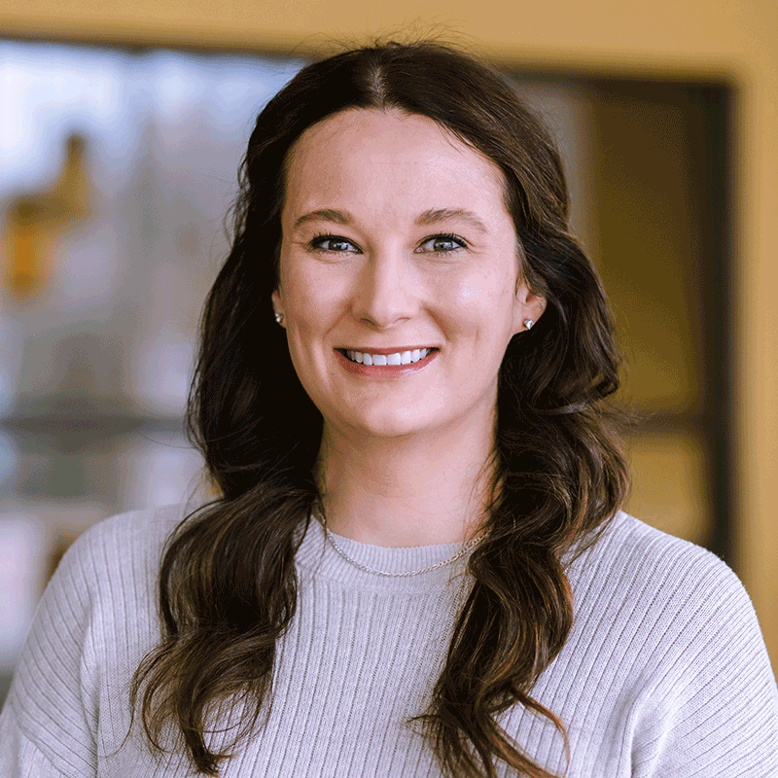
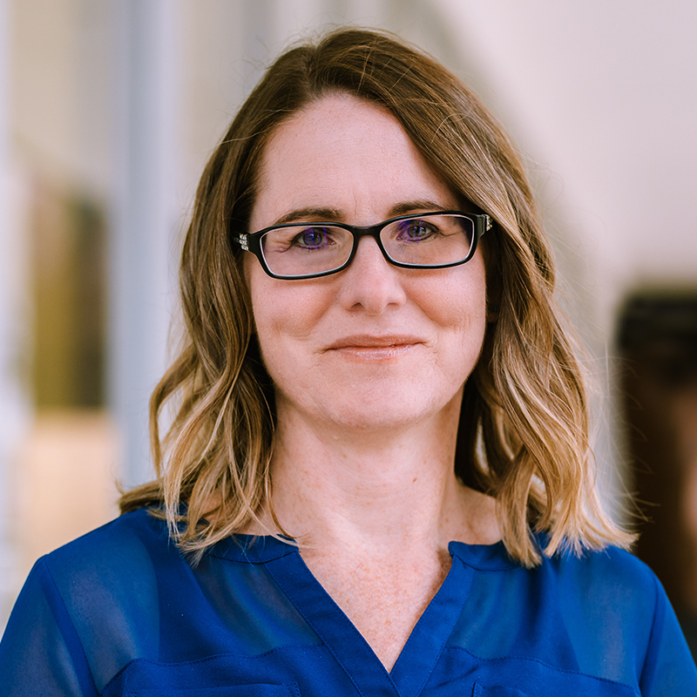
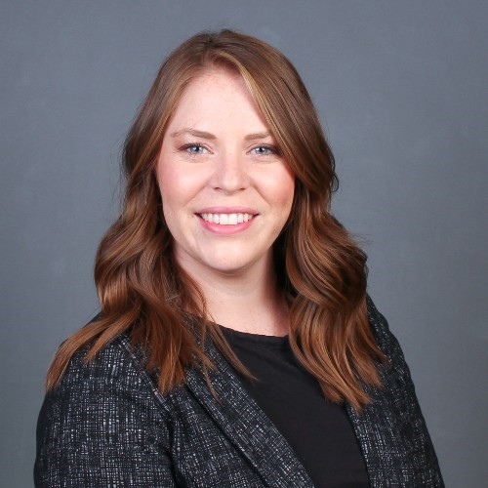
Team Introductions
Michigan Municipal League
Public Sector Consultants
OHM Advisors
Shanna Draheim, Director of Policy Research Labs
Melissa Milton-Pung,
Program Manager
Kristin Hofman,
Director of Content Marketing
Aimee Cain, Content and Event Specialist
Madison Merzlyakov, Client Representative
MC Moritz, Project Engineer

Slide 4
Polling Activity
Notes:
1. What type of community are you representing today?
Rural
Urban
Suburban
Other
2. What are your community’s top three needs in the natural resources and recreation space?
Funding for new facilities
Maintenance of existing facilities
Ecological restoration
Boating and fishing
Active recreation (sports)
Trail development and improvements

Slide 5
Agenda
MI Funding Hub overview
Feedback requested
Technical assistance
Work example: Imlay City
Q&A
Guest speakers
Jon Mayes, Michigan Department of Natural Resources
Justice40 cohort recap
Recap and adjourn

Slide 6
MI Funding Hub Review
Community eligibility
Database of federal and State of Michigan grants​
Technical assistance
Capacity building
Articles, toolkits, and other resources​
Ongoing newsletter and webinars
Justice40 communities cohort

Slide 7
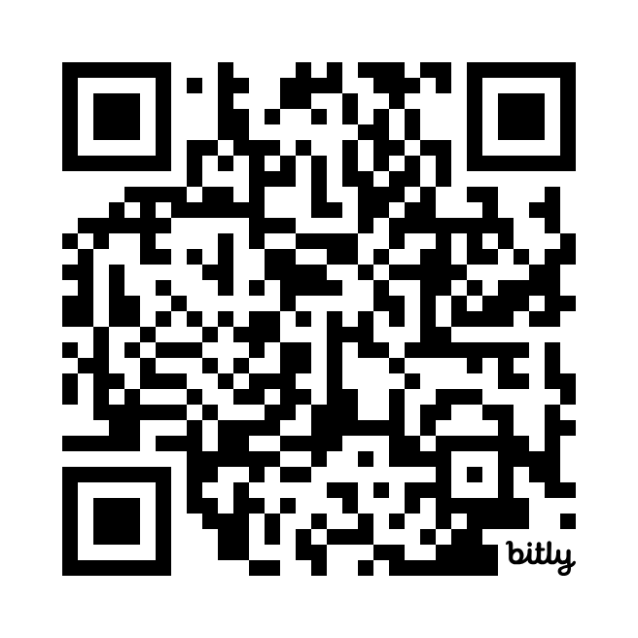
We want to hear from you!
Don’t be shy! Tell us what you think.
Your feedback is vital to the development of MI Funding Hub
Help us build the product to help you
Submit feedback via helpdesk@mifundinghub.org

Slide 8
Technical Assistance
helpdesk@mifundinghub.org
Send a message to the Helpdesk email address. We will reply with an intake form and follow-up questions.
Fill out the intake form and we’ll coordinate a time to meet virtually.
Talk to our grant experts to discuss funding gaps and opportunities. This meeting is usually 30–45 minutes long.
Receive follow-up support as needed. This support may include the Helpdesk searching for additional funding opportunities or peer reviewing your funding applications.

Slide 9
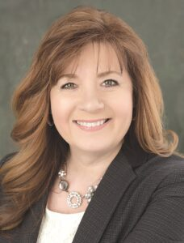
Imlay City + MI Funding Hub Helpdesk
Christine Malzahn
Downtown Development Authority Executive Director
Coaching Session
Peer Review
Community Center Pavilion

Slide 10
Questions on Helpdesk?
Questions?

Slide 11
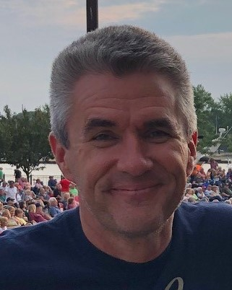
Guest Speakers
Jon Mayes
Recreation Grants Manager
Department of Natural Resources

Slide 12
Department of Natural Resources Recreation Grant Programs Mi Funding Hub

Slide 13
Recreation Grants
Michigan Natural Resources Trust Fund
Land and Water Conservation Fund
Recreation Passport Grant Program
Notes:
Recreation Grants (michigan.gov)

Slide 14
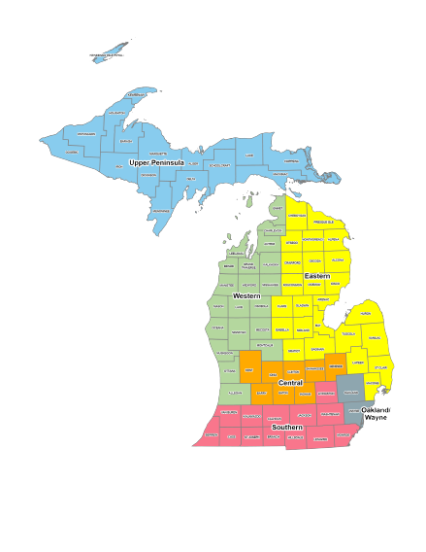
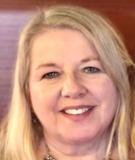
Regional Grant Coordinators
Merrie Carlock carlockm@michigan.gov Charamy Cleary clearyc1@michigan.gov | Upper Peninsula Region, Wayne & Oakland Counties Western Region
Samantha Davis daviss46@michigan.gov Riley Millard millardr2@michigan.gov | Eastern Region Central Region
VACANT | Southern Region

Slide 15
Grants Management Staff
Clay Summers
Grants Management Section Manager
Jon Mayes
Unit Manager & MNRTF Program Manager
Christie Bayus
LWCF, RPGP, ORLP & Marine Safety Grant Program Manager
Chip Kosloski
Wildlife Habitat & Fisheries Habitat Grant Program Manager
Erin Campbell
Invasive Species, Clean Vessel Act
Program Manager and Conversion Officer
Michael Chuff
Financial Specialist MNRTF
Michelle Ballard
Payment Officer for multiple grant programs
Krista Dickerson
Payment Officer for multiple grant programs
Dawn Miller
Payment Officer

Slide 16
Michigan Natural Resources Trust Fund - TF
2023 Results
Total Eligible Applications | 123 | $51.9 Million
Total Grants Recommended | 53 | $27.3 Million
Success Rates:
Development | 35% | $9.8 Million
Acquisition | 75% | $17.5 Million
2022 Results
Total Eligible Applications | 124 | $53.2 Million
Total Grants Recommended | 45 | $23.3 Million
Success Rates:
Development | 30% | $8.3 Million
Acquisition | 63% | $15 Million

Slide 17
Land and Water Conservation Fund - LWCF
2023 Results
Total Eligible Applications | 11 | $7.5 Million
Total Grants Recommended | 9 | $6.5 Million
Success Rate | 82%
2022 Results
Total Eligible Applications | 18 | $8.6 Million
Total Grants Recommended | 13 | $7.4 Million
Success Rate | 72%

Slide 18
Recreation Passport - RP
2023 Results
Total Eligible Applications | 47 | $5.5 Million
Total Grants Recommended | 15 | $1.98 Million
Success Rate | 32%
2022 Results
Total Eligible Applications | 35 | $4.4 Million
Total Grants Recommended | 14 | $1.9 Million
Success Rate | 40%

Slide 19
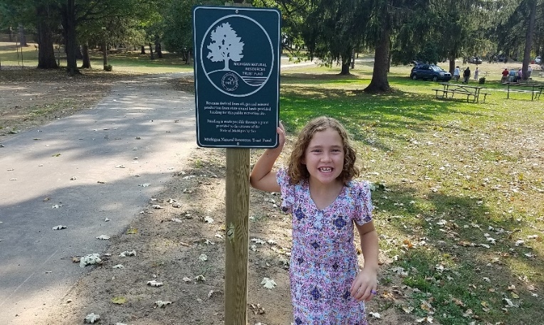
Anticipated Funding 2024
$2 Million
$5 Million
$21 Million

Slide 20
Eligible Applicants
State and Local Units of Government
Huron-Clinton Metropolitan Authority
Regional recreation authorities if DNR approved
Federally recognized Native American Tribes (LWCF)
Applicant must have:
DNR-Approved 5-year Recreation Plan
OR
Capital Improvement Plan (Recreation Passport only)

Slide 21
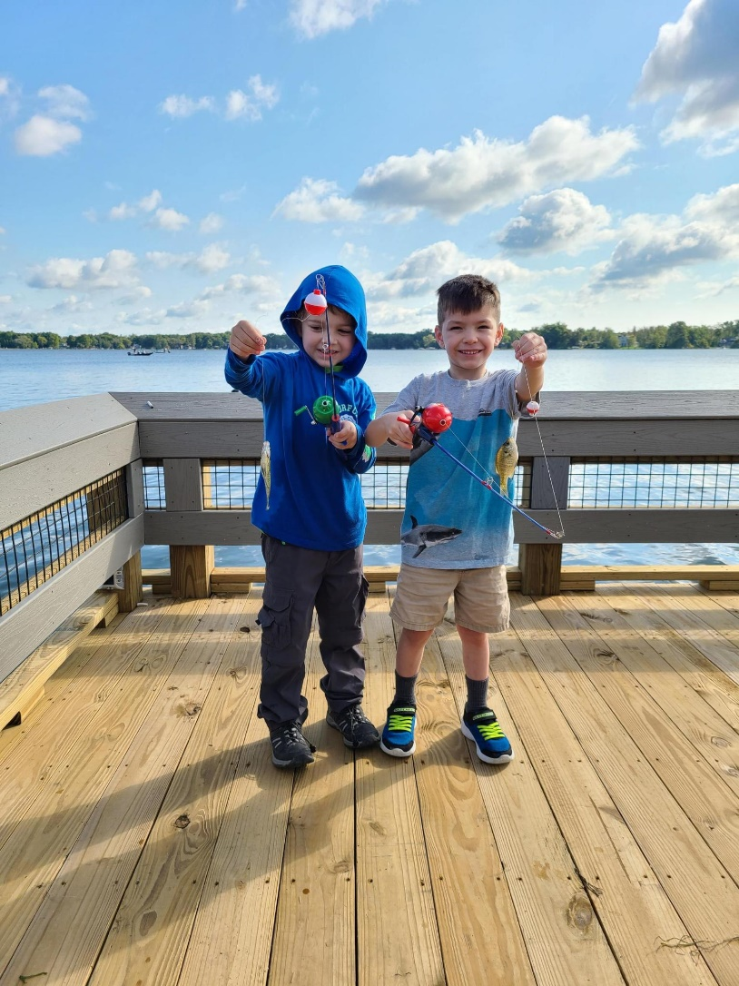
Eligible Projects
Acquisition of land or rights in land
MNRTF & LWCF
Development of public outdoor recreation
Development of indoor facilities - RP

Slide 22
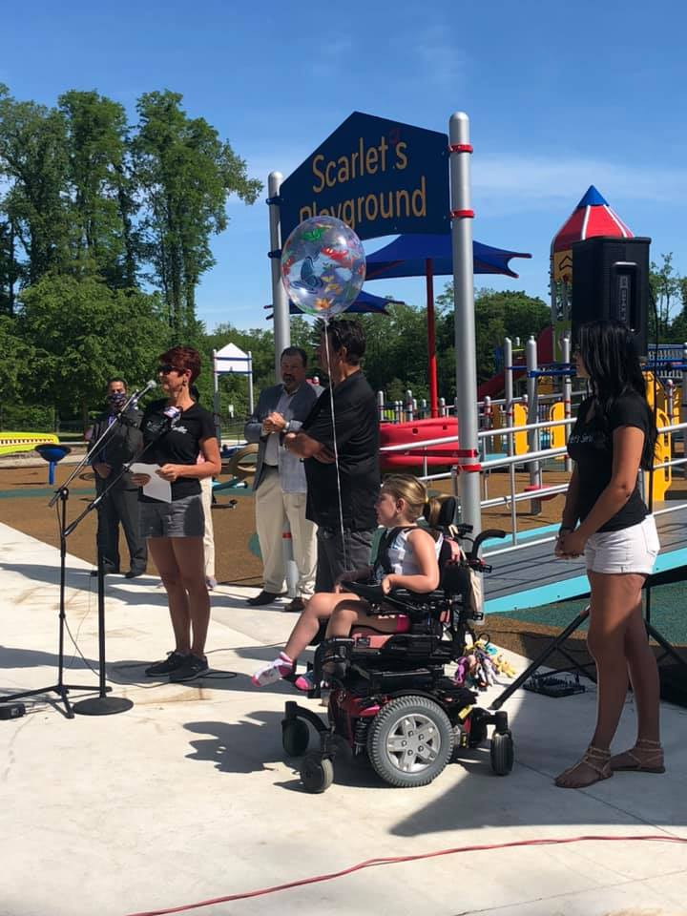
Development Projects
Trails & trailheads
Canoe or kayak launches
Marinas and boat launches
Fishing piers
Picnic pavilions
Athletic fields & Pickleball
Playscapes
Campgrounds
Restrooms and bathhouses
And More!

Slide 23
Grant Request Amounts
Reimbursement Grants – Based on Grant Percentage
 | Minimum | Maximum | % Match
TF Acquisition | N/A | N/A | 25% min
TF Development | $15,000 | $400,000 | 25% min
LWCF Acquisition | N/A | N/A | 50% fixed
LWCF Development | $30,000 | $500,000 | 50% fixed
Rec Passport | $7,500 | $150,000 | 25% min

Slide 24
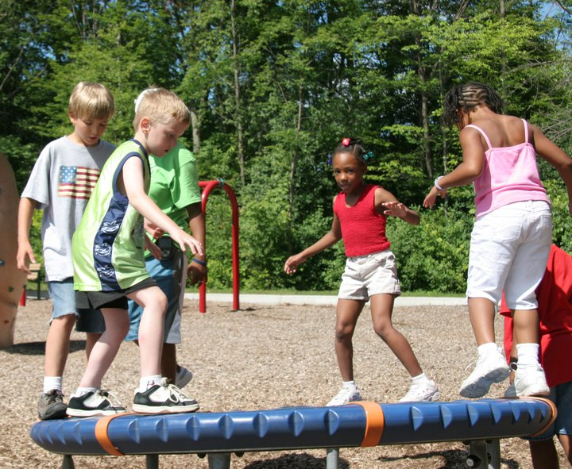
Eligible Match Sources
General Fund
Donations
Some Other Grants
Volunteer labor
Force account labor
Community owned materials

Slide 25
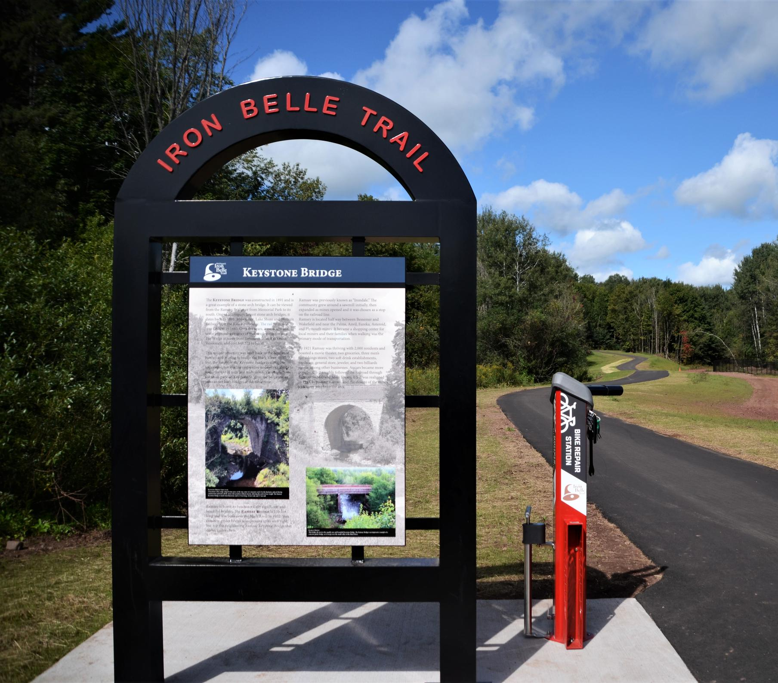
Site Control Requirements
Fee Simple Ownership
Permanent Easement
Trails in ROW must have road agency permission

Slide 26
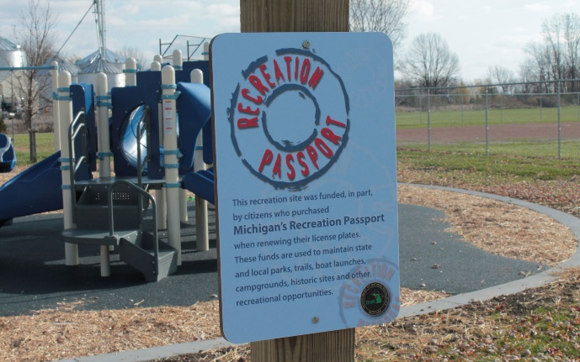
Long-Term Obligations
Open to the public
Well maintained
Program acknowledgement
plaque required
MNRTF & LWCF – site must remain in public outdoor recreation in perpetuity
RP – public outdoor recreation 20 years or 40 years for structures

Slide 27
Application Timeline
January Applications Open in MiGrants
February 1 New 5-Year Recreation Plans Due
April 1 Application Deadline
April / May Administrative Review
June / July Site Visits & Staff Scoring
September Preliminary Scores Issued

Slide 28
Application Timeline (cont.)
October Supplemental Information Due
November Final Scores Released
November Director Recommendations RP/LW
December MNRTF Board Recommendations
January MNRTF Legislation Transfer

Slide 29
Grant Timeline
RP: Projects Agreements (PA) issued in January
MNRTF: Legislative and Governor Approval May take 4-6 months before PA issued
LWCF: National Park Service Approval before PA
Grantee has 2 years to complete the project
May begin certain activities on January 1

Slide 30
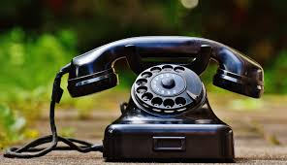
Contact Information
Email: dnr-grants@michigan.gov
Phone: 517-28-GRANT (517-284-7268)
Program Information and Forms:
www.michigan.gov/dnr-grants
Sign up for e-mail updates:
www.michigan.gov/dnr

Slide 31
Questions?
Thank you!

Slide 32
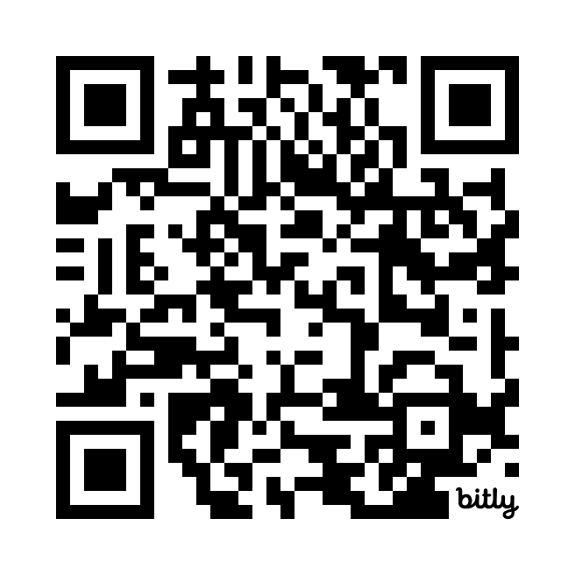
MI Funding Hub and Justice40
Capacity-building cohort
First cohort finishes next week
Launch of cohort two coming soon
Sign up to be invited
Notes:
Drop link in the chat

Slide 33
Upcoming Grant Opportunities
Don’t forget about these …
Michigan Arts and Culture Council: Experience Support
Department of Environment, Great Lakes, and Energy: Michigan Maritime Strategy

Slide 34
Closing
What’s Next?
Justice40 cohort two launch
September 26, 2024, webinar
Continuously adding grants to the database
Helpdesk will continue to provide support

Slide 35
Contact Us
Helpdesk email
helpdesk@mifundinghub.org ​
Sign up for monthly newsletters
https://mml.org/programs-services/mifundinghub/signup/

Slide 36
Thank you!

