Slide 1
Welcome!
April 24, 2025

Slide 2
Helping Michigan municipalities navigate new state and federal funding opportunities
Funding support provided by the Michigan Department of Labor and Economic Opportunity;
the Michigan Municipal League (MML) team is available now to help communities understand and successfully pursue state and federal recovery and infrastructure funding.

Slide 3
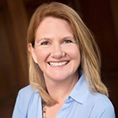
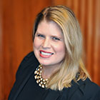
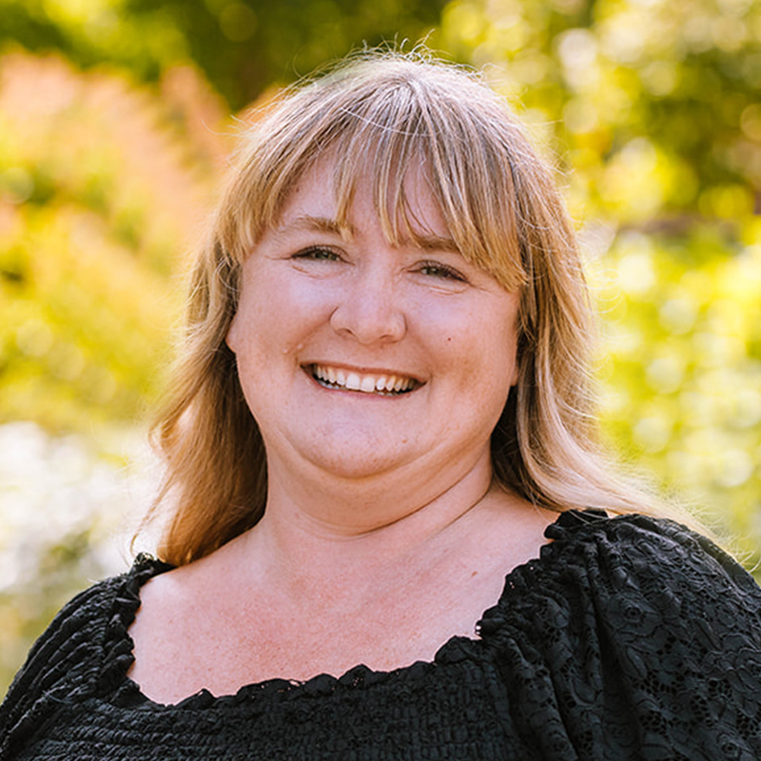
Team Introductions
Michigan Municipal League
Public Sector Consultants
Shanna Draheim, Director of Policy Research Labs
Melissa Milton-Pung,
Program Manager
Julie Durham,
Director
Meagan O’Brien, Consultant

Slide 4
Polling Activity

Slide 5
Agenda
MI Funding Hub Program Summary
Guest speaker
MI Funding Hub Updates
Grant basics
Grant opportunities
Closing

Slide 6
MI Funding Hub Review
Database of federal and State of Michigan grants​
Articles, toolkits, and other resources​

Slide 7
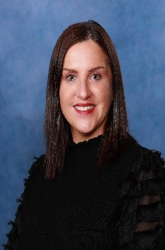
Guest Speaker
Kelly Hon
Source Water Protection Specialist
Michigan Rural Water Association

Slide 8
MI Funding Hub Updates

Slide 9
Grant Basics
Evaluating Grant Outcomes
Determine what needs to be evaluated
Project objectives
Impact
Evaluation requirements determined by the funder
Determine the right data to use in your evaluation
Surveys
Focus groups
Number of residents served or changes in resident perceptions
Revenue generated

Slide 10
Grant Basics
Evaluating Grant Outcomes
Methods for communicating project success
Detailed report
Presentation
Fact sheets
Visuals and accessible language can communicate the results and impact of your program to the public
The funder may have other required reporting formats.

Slide 11
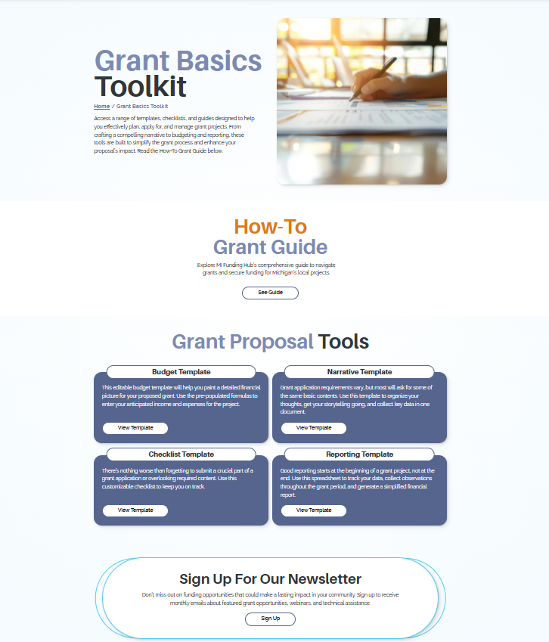
Grant Basics Toolkit
On Our Website
The Grant Basics Toolkit is now live on the MI Funding Hub website!
https://mifundinghub.org/grant-basics-toolkit/
A one-stop-shop resource for grant writing guidance. Find the tips shared in previous newsletters and webinars and more!

Slide 12
Grant Updates
Check out these opportunities
Community Empowerment Awards
Application deadline: Friday, May 16
Safe Routes to Schools Major Grant
Application deadline: Wednesday, June 18
T-Mobile Hometown Grant Program
Application deadline: Monday, June 30

Slide 13
Closing
What’s Next?
Access to toolkits, resources, and the grant database will continue

Slide 14
Contact Us
Helpdesk Form
https://mifundinghub.org/get-assistance/ ​
Sign up for monthly newsletters
https://mml.org/programs-services/mifundinghub/signup/

Slide 15
Thank you!

